Slide 1

Month 1
Weeks 0-2 after Conception
Notes:
This first slide show presentation will cover the first few weeks of human development during pregnancy. During these first few weeks, fertilization occurs, and the new life grows at an exponential rate.

Slide 2
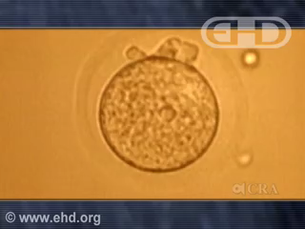
Fertilization
Notes:
FERTILIZATION AND CONCEPTION
Recall from our terms that fertilization occurs when the reproductive cells of the man and woman, the sperm and ovum cells, combine to become a new organism, genetically and physically unique from both mother and father, called a zygote.
As we can see in the video, the single cell zygote makes its first cell division just a little over a day after fertilization. Ongoing cell division will continue rapidly - developing into essential organs and systems.
It is worth noting that all of the genetic data needed for the entire earthly life of this new person, and the soul of this person (share this if you are in faith-based schools) are present at the moment of conception- present in this zygote. If fertilization had occurred just half a second before or after its actual occurrence - by a different sperm cell, then the genetic material of this new person would be completely different. It is important to note that there are 80-300 million sperm present – therefore there are 80-300 million possibilities of a new human person with its own soul, unique genetics and DNA – that determine gender, hair color, eye color, height, skin tone, and even personality traits. Each new individual, and each one of us, are therefore entirely unrepeatable, irreplaceable, and truly one in a million (or one in 80-300 million to be exact).

Slide 3
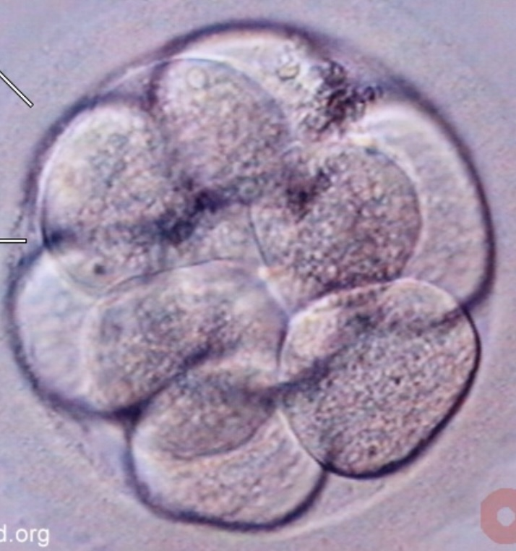
Days 1-4:
Conception and Cell Division
8-cell zygote
Photo Credit: Endowment for Human Development
Notes:
Days 1-4: Cell Division
When conception occurs, it does not occur within the womb. The sperm cells travel to where the ovum cell is located: inside the tubes that connect the uterus and the ovaries. These tubes are called fallopian tubes.
Cell division then begins, and the zygote is now referred to as an embryo, the name given to the pre-born person once cell division begins, lasting until the end of the eighth week of pregnancy.

Slide 4
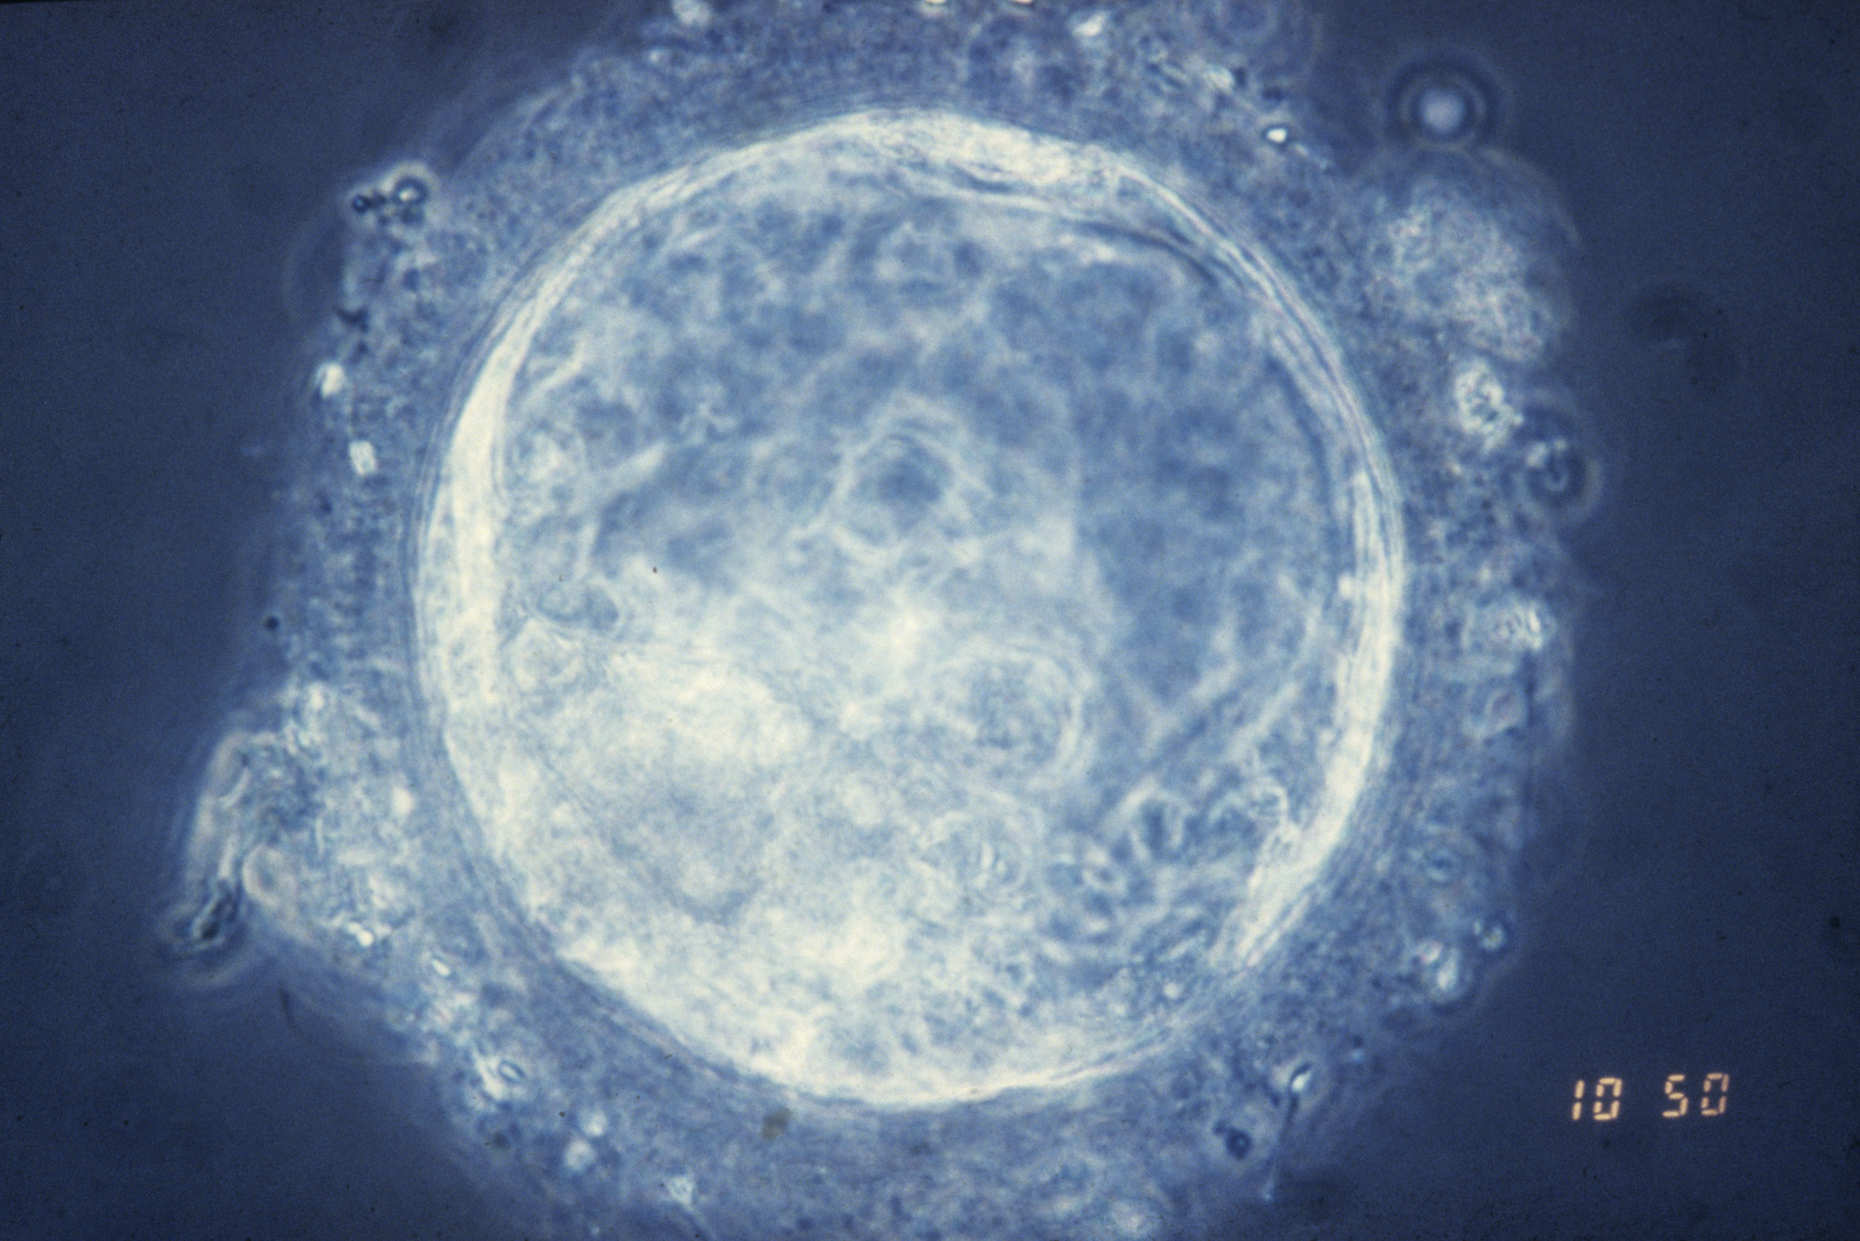
Days 5-12: Implantation and Formation
Blastocyst
Photo Credit: Science Photo Library
Notes:
When the embryo has grown into a cluster of about 100 cells, 5-7 days after conception, it is now referred to as a blastocyst and makes its way to the uterus. This tiny bundle of cells then implants into the uterus lining where it will grow and receive nutrients from the mother.

Slide 5
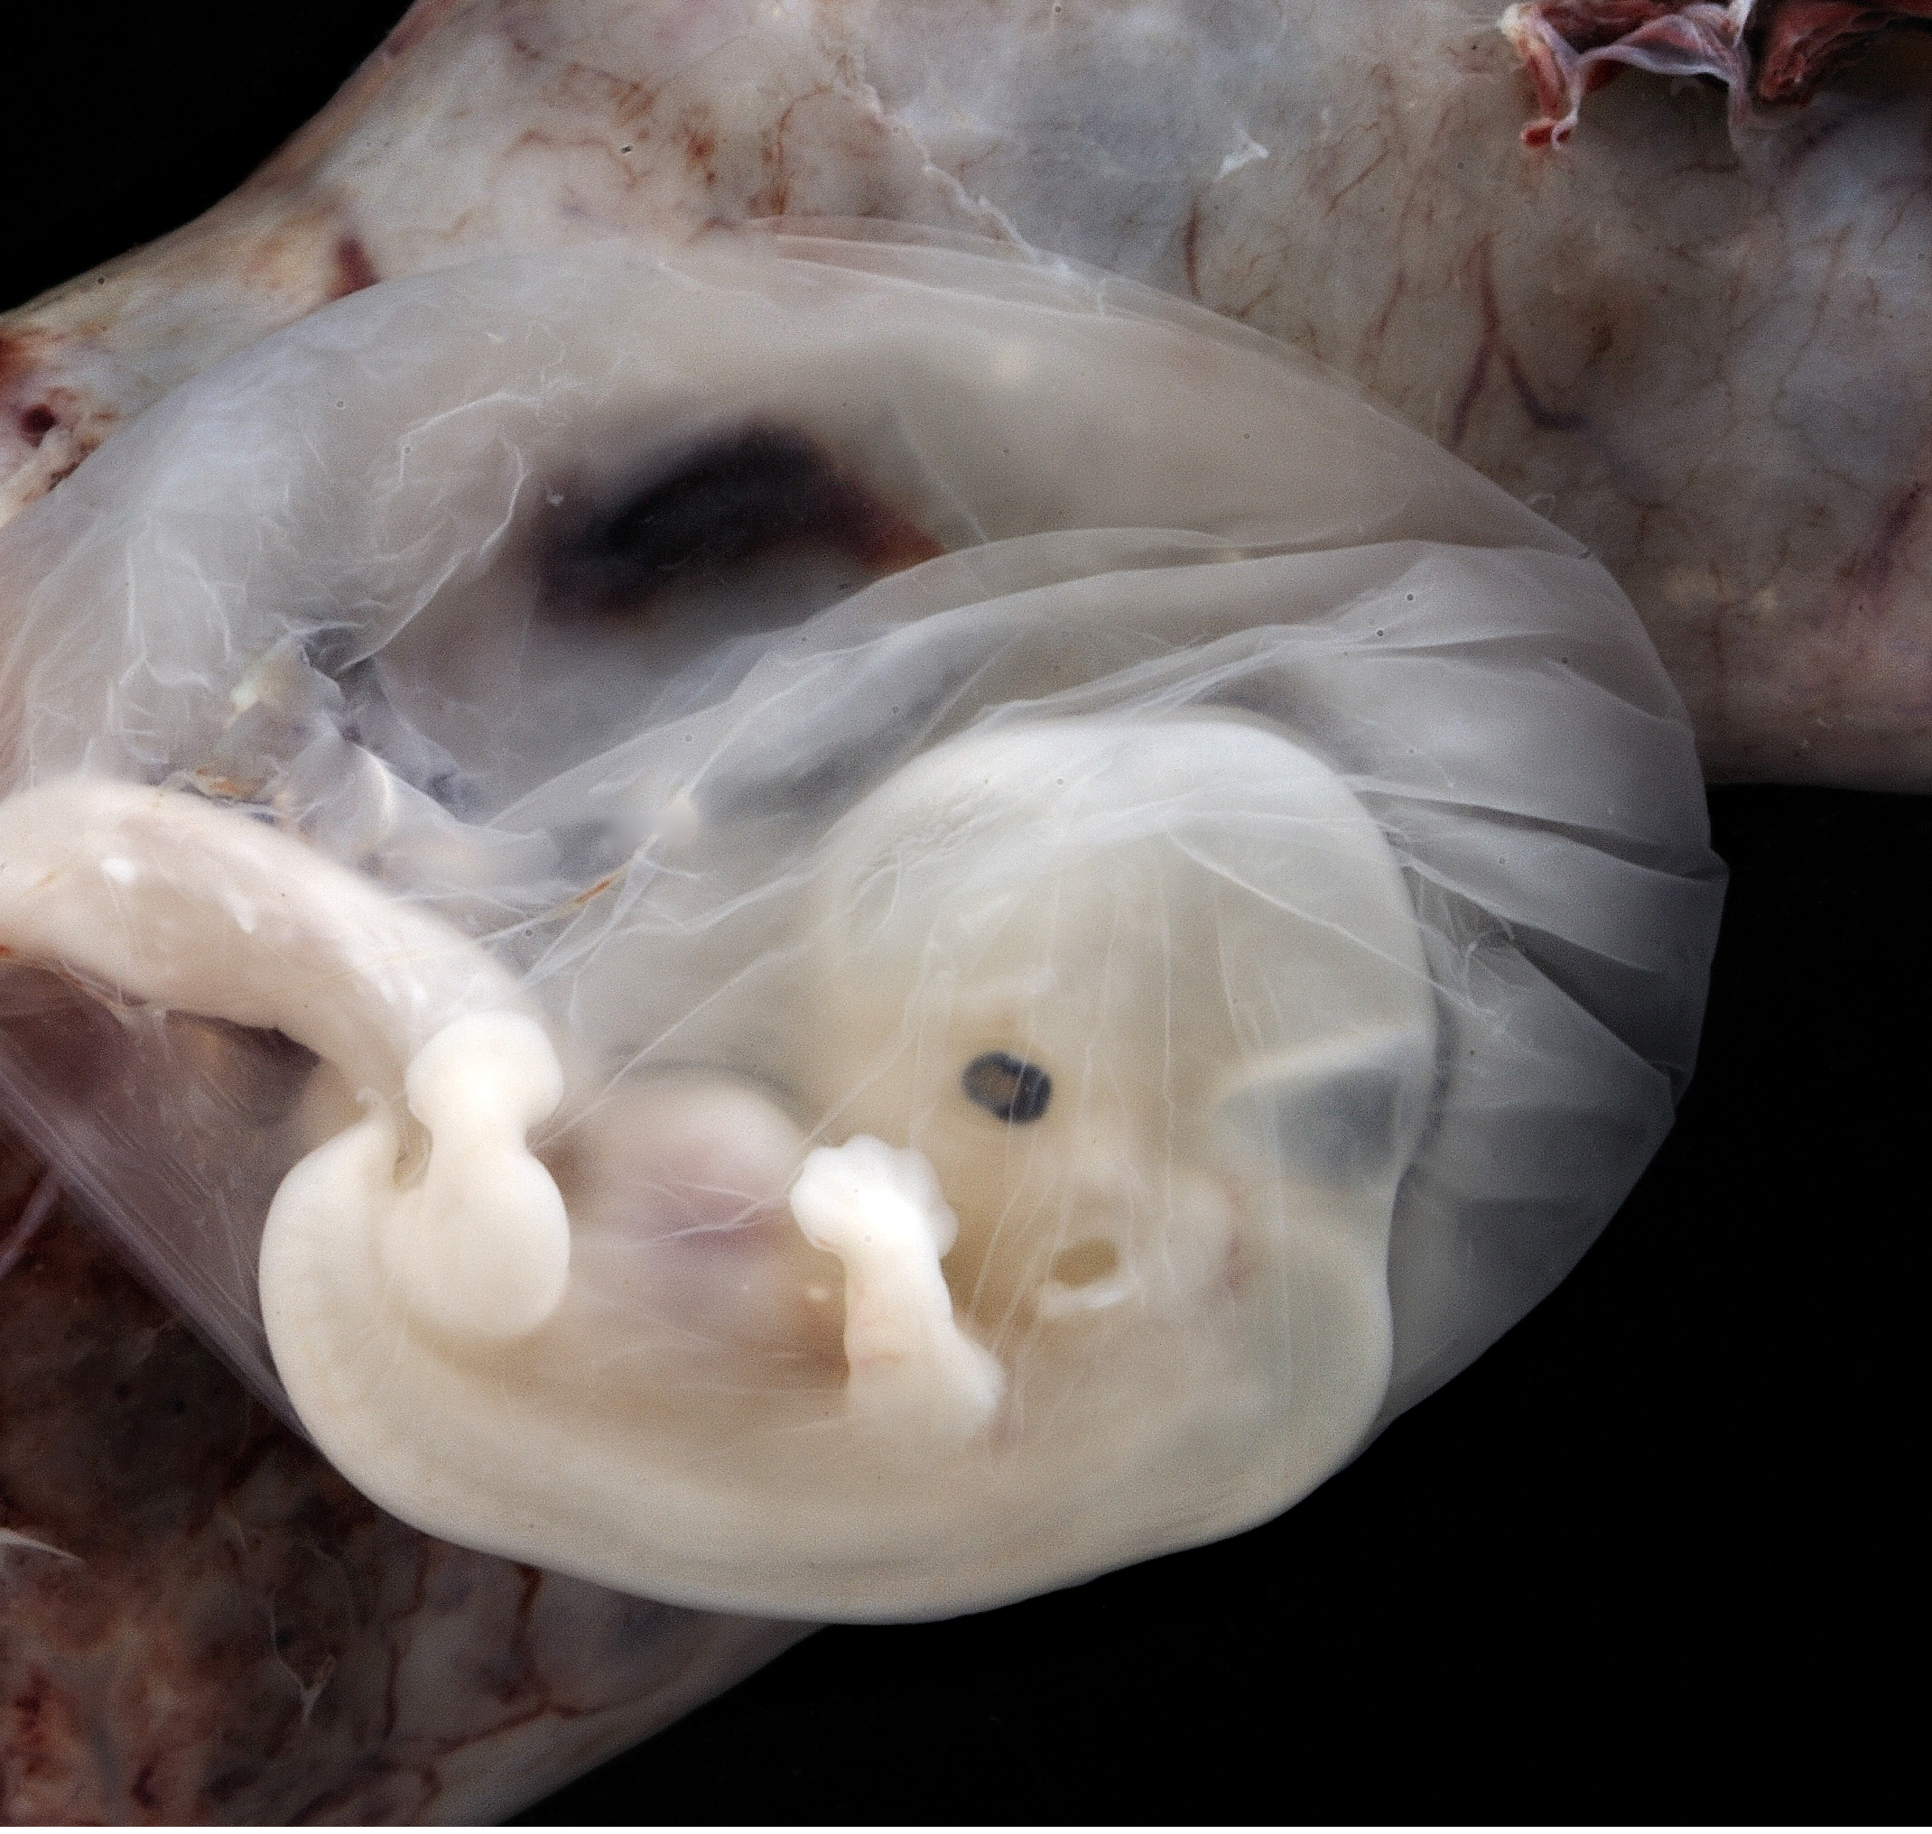
6-7 Weeks after conception highlighting amniotic sac and placenta
Forming Placenta
Amniotic Sac
Notes:
As the embryo begins to implant into the wall of the mother’s uterus, the amniotic sac begins to form. The amniotic sac surrounds the growing human being and provides protection throughout pregnancy.
It is worth noting that the image on this slide is taken from an embryo that is 6-7 weeks of age, not 5-7 days of age. The purpose of this image is to show the amniotic sac that we are referring to in the information above.

Slide 6
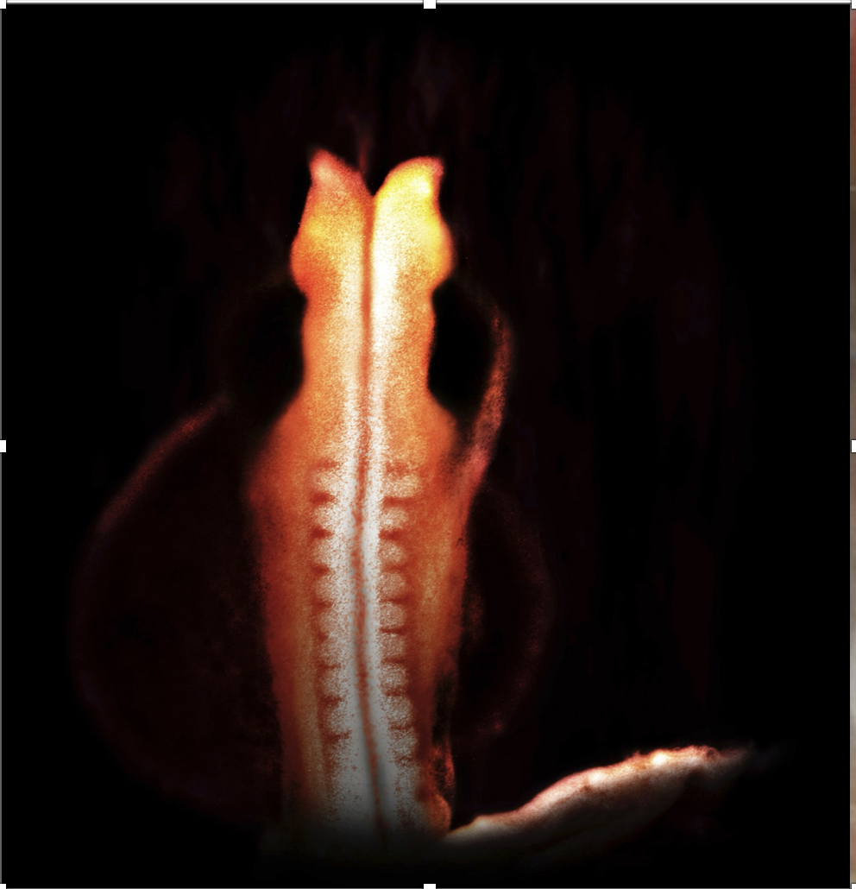
Days 20-23
MRI of 22 day old embryo
Photo Credit: Photo Science Library
Notes:
The rapidly growing child’s heart starts to beat at just 19-22 days old - when the whole embryo is only the size of the period at the end of a sentence. Most often the mother doesn’t even know that the tiny pre-born person is present and is still unaware that she is pregnant.
At the same time, the baby’s brain, spinal cord, and nerves begin to form. These are the parts that help the body think, move, and feel.
This MRI scan photo shows the pre-born person at the age that his or her heart begins to beat. It also shows the beginnings of the spinal cord and skeletal muscular system. Can you find the neural tube, which serves as the precursor for the spinal cord? Can you find the white ridges on the sides of the neural tubes- called somites, which are the basis for the development of the skeletal muscular system?
At the end of month 1, the pre-born person is only about the size of a poppy seed or a period at the end of the sentence but remember -the heart is already beating.

Slide 7
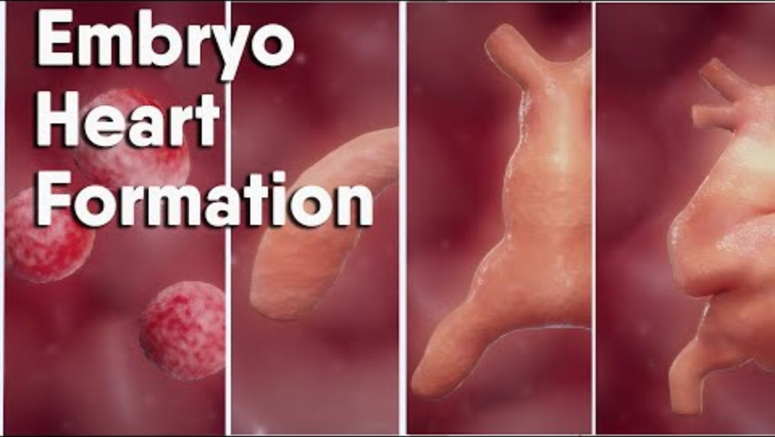
Notes:
This is an outstanding 2.5 min video about the development of the heart in the womb.

Slide 8

Supplemental Materials
Notes:
TEACHERS ARE WELCOME TO USE THESE

Slide 9
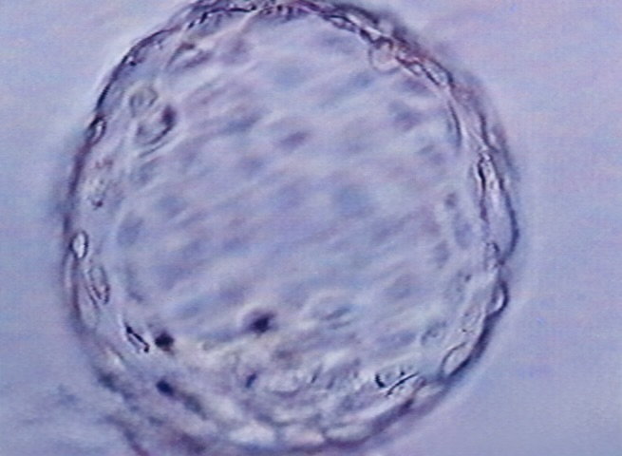
How A Pre-born Person Starts to Grow
Cell Division
1. First Split
After the egg of a mom is fertilized (this is called a zygote), the cell splits into two.
2. More Splits
Those two cells split again to make four, then eight, then sixteen, and so on. The number of cells keeps growing really fast.
3. Morula Stage
After about 3 days, there are around 16 cells. They form a little ball that looks like a mulberry. This ball is called a morula.
4. Blastocyst Stage
A few days later, the morula turns into a blastocyst. This is a hollow ball of cells with a group of cells inside and a layer of cells outside.
5. Implantation
The blastocyst travels to the uterus (where babies grow) and sticks to the wall. This is when pregnancy officially begins.
6. Special Jobs
As the cells keep dividing, they start to take on different jobs. Some will become the baby (called the embryo), and others will help support it (like the placenta).
7. Mitosis
All this cell splitting happens through a process called mitosis, which makes sure each new cell has the right set of instructions (DNA).
Notes:
This slide features the steps of cell division on one organized page. Going through each step is a good review and summary of the lesson for the end of class.

Slide 10


Your Life Before Birth
Video Credit: Endowment For Human Development
Notes:
This is a 7 ½ minute video that captures the full development of the human being in the womb. It can be shown at any time during this educational program to highlight what occurs throughout pregnancy. It might be good to use as a refresher after a holiday or break and is a good way to begin. It will be shown in month 9 during the main PowerPoint presentation.

Slide 11
Discussion Questions
Notes:
Teachers, please refer to discussion questions in curriculum book.

Slide 12
Resources
https://www.youranswermatters.org/explaining-the-spark-of-life-at-conception/
Easterwood Ashley : “Explaining the “Spark of Life” at Conception |Pregnancy Resource Science| March 14, 2024
Fetal Facts: Cleveland Clinic: https://my.clevelandclinic.org/health/articles/9699-first-trimester
Fetal-Facts Mayo Clinic: https://www.mayoclinic.org/healthy-lifestyle/pregnancy-week-by-week/in-depth/prenatal-care/art-20045302
Northwestern University, Photo of Zink Spark, Spark of Life.
Science Alert: “Scientists Just Captured The Flash of Light That Sparks When A Sperm Meets an Egg” Humans| April 27, 2016 By BEC Crew
https://www.sciencealert.com/scientists-just-captured-the-actual-flash-of-light-that-sparks-when-sperm-meets-an-egg
Science Photo Library, 22 day old MRI scan.
Science Photo Library: Blastocyte Image
American Surrogacy. (n.d.). Day-by-day embryo development timeline. Retrieved July 17, 2025, from https://www.americansurrogacy.com/parents/day-by-day-embryo-development-timeline
Charlotte Lozier Institute. (n.d.). Highlights of the early heart. Retrieved July 17, 2025, from https://lozierinstitute.org/dive-deeper/highlights-of-the-early-heart/^
Tan, C. M. J., & Lewandowski, A. J. (2020). The transitional heart: From early embryonic and fetal development to neonatal life. Fetal Diagnosis and Therapy, 47(5), 373–386. https://doi.org/10.1159/000501906
Asp, M., Giacomello, S., Larsson, L., Wu, C., Fürth, D., Qian, X., Wärdell, E., ... & Lundeberg, J. (2019). A spatiotemporal organ-wide gene expression and cell atlas of the developing human heart. Cell, 179(7), 1647–1660. https://doi.org/10.1016/j.cell.2019.11.025
Tan C, M, J, Lewandowski A, J: The Transitional Heart: From Early Embryonic and Fetal Development to Neonatal Life. Fetal Diagn Ther 2020;47:373-386. doi: 10.1159/000501906; Asp, Michaela, Stefania Giacomello, Ludvig Larsson, Chenglin Wu, Daniel Fürth, Xiaoyan Qian, Eva Wärdell et al. 'A spatiotemporal organ-wide gene expression and cell atlas of the developing human heart.' Cell 179, no. 7 (2019): 1647-1660. https://doi.org/10.1016/j.cell.2019.11.025
Muñoz, J. L. (2024, November). Stages of fetal development. In Merck Manual Consumer Version. Baylor College of Medicine. Retrieved from https://www.merckmanuals.com/home/women-s-health-issues/normal-pregnancy/stages-of-fetal-development
The Endowment for Human Development, Prenatal Form and Function: Fertilization – Forming a Single Cell Embryo n.d. https://www.ehd.org/dev_article_unit1.php#CLSfertilization
The Endowment for Human Development, "Your Life Before You Were Born", n.d. https://www.ehd.org/your-life-before-birth-video/

