Slide 1

Month 2
Weeks 3-6 after Conception
Notes:
In month two, the pre-born person will be rapidly developing all the essential limbs and organs that allow us to live and move in the world outside the womb.
Recall from last month, that at this stage, the heart of the pre-born person is already beating. If you recall, it started beating at just 19-22 days (about 3 weeks).

Slide 2
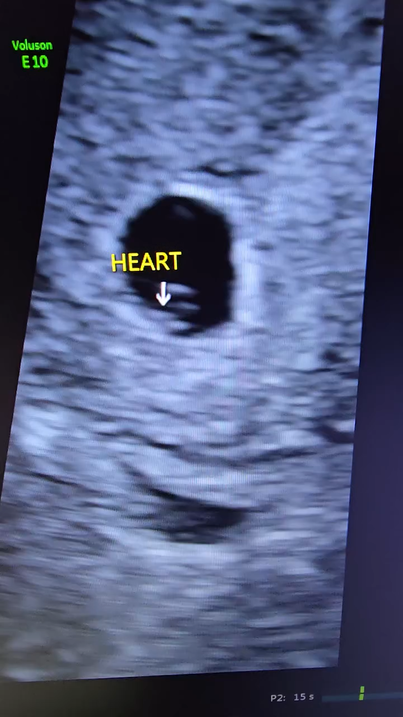

3 Weeks 6 Days
3 Weeks & 6 Days
^{CREDIT: 4 D ULTRASOUND LADY}
Notes:
During this month, that same heartbeat can be heard and seen through ultrasound technology. This is the slide that we are going to start with – seeing the pre-born person’s heartbeat on ultrasound at just 3 weeks 6 days.
This is a 6 second video. Give your students the challenge of raising their hands as soon as they see the heart movement. Consider playing the video several times.

Slide 3
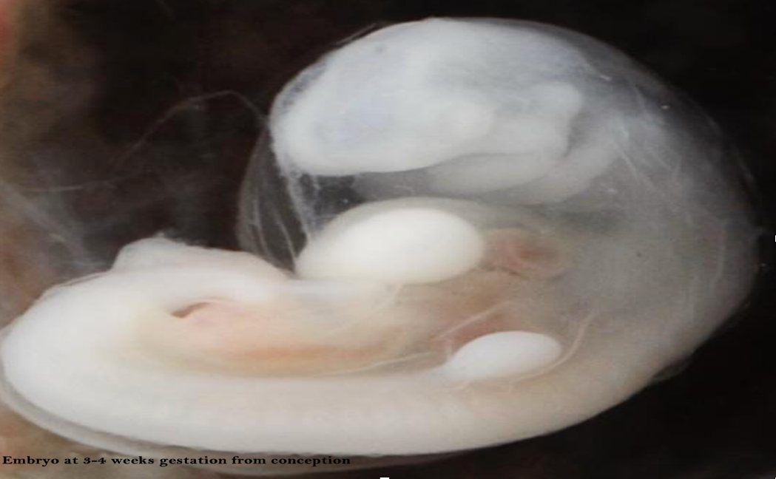
Heart rate detected.
3 weeks after conception. Photo Credit: Lunar Caustic
Notes:
This is a closer look at what you looked like when your heart was first beating, and you were referred to as an embryo.
The structures needed for the ears, eyes, and mouth are also forming at this stage of development.

Slide 4
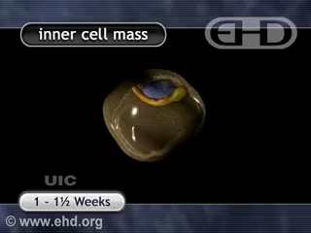
Notes:
The embryo is composed of three layers:
ECTODERM: Develops skin, nervous system, eyes, and inner ear.
MESODERM: Forms the heart, circulatory system, bones, ligaments, kidneys, and reproductive system.
ENDODERM: Becomes lungs and intestines.
We are now going to watch this 1 ½ minute video that shares about the formation of the ectoderm, mesoderm, and endoderm.

Slide 5
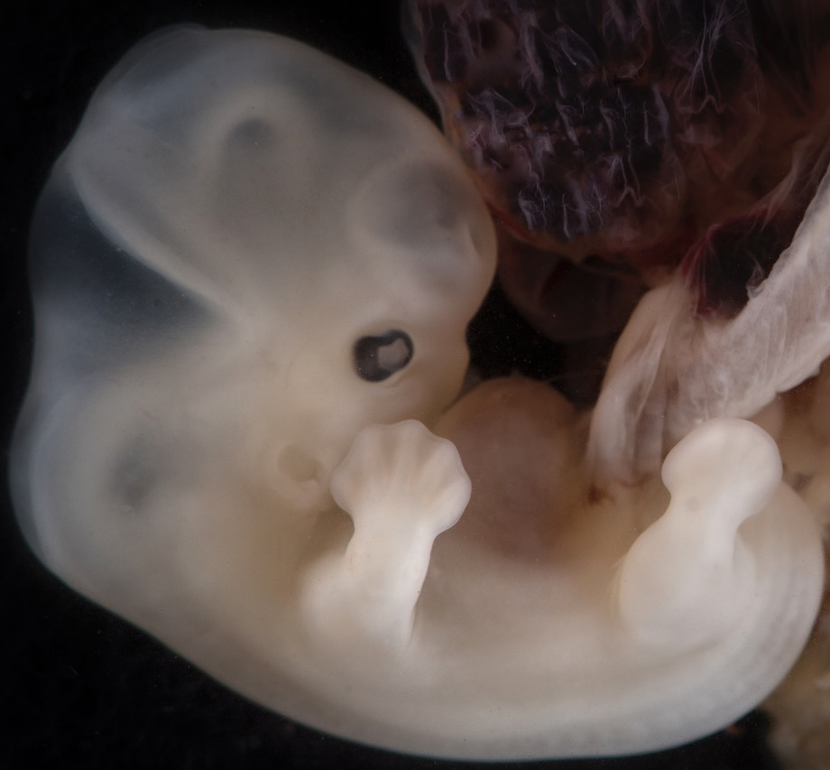

Arms & legs forming.
5-6 weeks after conception Photo Credit: Lunar Caustic
Notes:
As we can see in this incredible imagery, a lot of growth is happening here in Month 2.
5 weeks after conception:
The face and brain continue to develop.
Limb buds appear; legs begin forming; arms and feet resemble paddles.
The umbilical cord – evident in this photo – sustains life. Who knows what the umbilical cord brings to the pre-born person? (answer: it brings nutrients and oxygen from the mother to the pre-born person) When the baby is born, the umbilical cord is severed, and what mark do we all have to show where this lifeline was? (answer: belly button) It is important to note that when the cord is cut, it does not hurt the baby as it contains no sensory nerves. Just like when you trim your fingernails, it does not hurt. It is the same with the cutting of the umbilical cord.

Slide 6
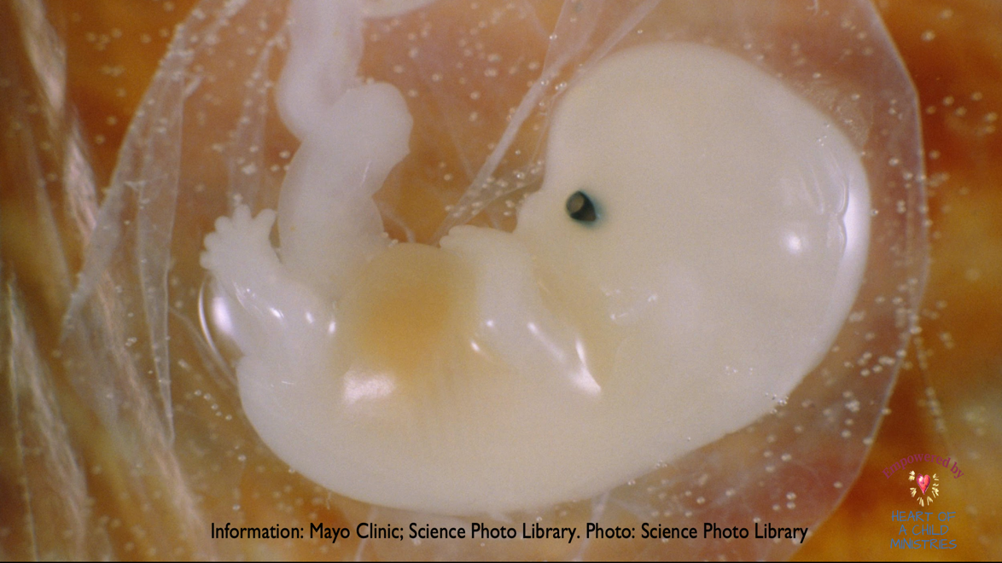
All organs developing.
Notes:
Only one week later, 6 weeks after conception:
All major organs and body systems are forming.
Paddles change to fingers.
Eyes become more prominent.
Most often, women are just discovering that they are pregnant- at this 4–6-week range.
By the end of month 2, the term for a pre-born person will change from “Embryo” to “Fetus” and he or she is now about 0.5-1 inch long, the size of a kidney bean.
***If you are a faith-based school, please show slide 8 in the supplemental materials now. The teaching about the heart in these slides is the center of the faith-based program and is referenced in the supplemental spiritual reflections.

Slide 7

Supplemental Materials
Notes:
Supplemental Materials:
Teachers are encouraged to use these additional supplemental materials to take a deeper dive into the fetal development information. These resources include additional short video segments and images that offer expanded insights into fetal development stages. They are ideal for enriching classroom discussions, supporting differentiated instruction, or exploring the subject in greater detail.

Slide 8
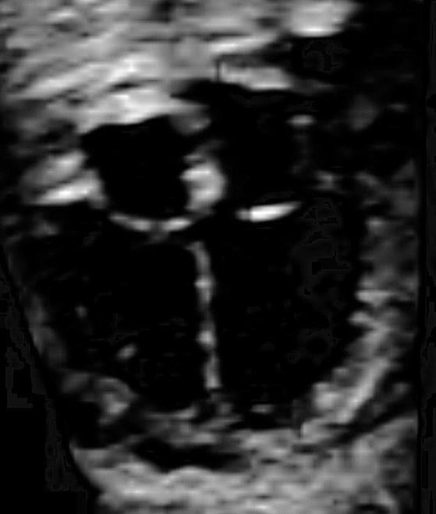
"Ultrasound of 20 week fetal heart". Credit: Kathy Havranek, sonographer
Notes:
We started this lesson by seeing the heartbeat of the pre-born person. Let us recall that beating (pause). Now I ask you, what shape do you see in the center of this photo? (Answer: A cross). Yes, this looks like a cross, but it is the heart of a pre-born person at 20-weeks old. As your heart grows and develops from that first beat to being fully formed at about 20-weeks, the tissue in the center of the four chambers forms a cross.
This is not an accident. God arranged everything as He wanted when He created us. This mark represents our true identity. We are the Body of Christ, Made in His image, meant to be His hands and feet in the world - meant to receive His love in our hearts and bring it to others.
Teachers: Take time to have students do the spiritual reflection which takes this concept further.

Slide 9
3 Weeks 6 Days
3 Weeks & 6 Days
^{CREDIT: 4 D ULTRASOUND LADY}
Notes:
This is the 6 second video showing the heart pulsing at just 3 weeks after conception that you showed previously. There is a story behind this video that you can share with your students if you would like to explore medical ethics regarding life and the importance of being your own medical advocate.
Story behind this video: A mom had a positive pregnancy test and went in for an ultrasound a little before 3 weeks after conception. The sonographer only saw a gestational sac (the sac that the baby would grow in), but she did not notice a heartbeat and assured her that this was normal at this stage. She suggested that she give the heart time to mature and come back in a week. The mom called her doctor and told him that only the gestational sac was seen on the ultrasound and showed him the photos. They immediately told her that she miscarried and gave her medication that would expel everything in her uterus. The mom didn't feel quite right about taking this medication, and she went back to the sonographer before taking the meds to get another ultrasound. At that appointment - just one week later - at 3 weeks and 6 days - they found the heartbeat. The baby could continue to grow, develop and be born.
This story confirms that just as there is variance in every human person there can be variance as to when the heart starts to beat - sometimes right at 22 days, sometimes a little earlier or later. It also confirms - that even though doctors are a gift and have great knowledge - they do not always know everything, and it is important to trust yourself and be your own advocate. Does anyone have any thoughts about this or any stories where you or a family member had to be your own medical advocate?

Slide 10
DISCUSSION QUESTIONS
Notes:
TEACHERS PLEASE REFER TO TEACHING GUIDE FOR DISCUSSION QUESTIONS.

Slide 11
Resources
Fetal Facts: Cleveland Clinic: https://my.clevelandclinic.org/health/articles/9699-first-trimester
Mayo Clinic Fetal Facts: https://www.mayoclinic.org/healthy-lifestyle/pregnancy-week-by-week/in-depth/prenatal-care/art-20045302
5-6 week-pre-born person after conception. Photo Credit: Science Photo Library
6-weeks after conception, pre-born person. Science Photo Library.
Dandelion Medical Animation, April 30, 2022, Do you know how is the Heart Formation In Embryo? heart formation embryology animation, https://www.youtube.com/watch?v=Ze7YO28wwao
Dewald, O., & Hoffman, J. T. (2023, July 24). Gestational Sac Evaluation. MD Searchlight. Retrieved from https://www.ncbi.nlm.nih.gov/books/NBK551624/
Moore Institute: "Fun Facts About the Placenta", https://www.ohsu.edu/school-of-medicine/moore-institute/fun-facts-about-placenta
The Endowment for Human Development, Prenatal Form and Function: Fertilization – Forming a Single Cell Embryo n.d. https://www.ehd.org/dev_article_unit1.php#CLSfertilization

