Slide 1

Month 3
Weeks 7-10 after Conception
Notes:
In Month 3, many of the more complex systems of the pre-born person are developing. There is also a lot more movement going on at this point, with observable activity and “practice” motions to help strengthen the baby’s developing muscles, joints, and skeleton.

Slide 2
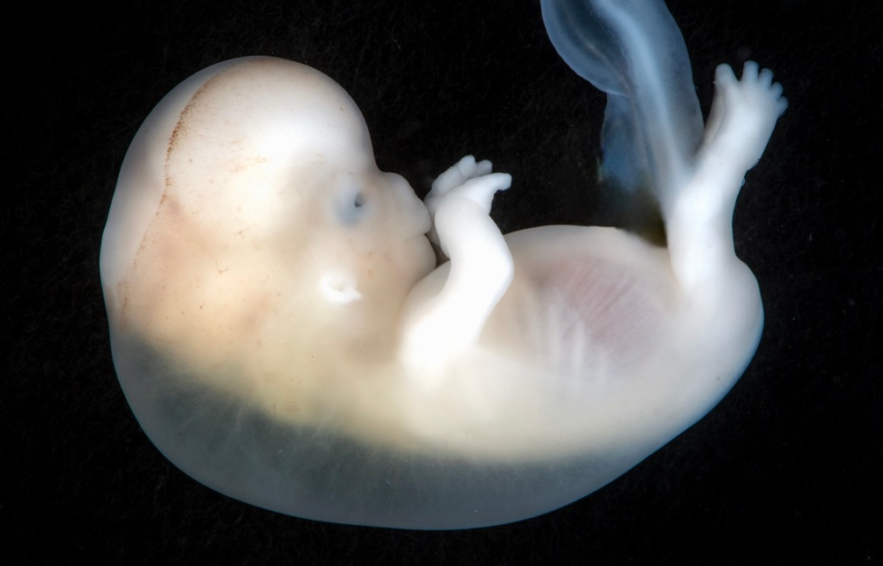

Teeth are growing.
9 weeks after conception. Photo Credit: Lunar Caustic
Notes:
9 weeks after conception, teeth and taste buds are forming. This means that the baby’s taste preferences are going to start forming as they practice eating and swallowing motions (hold up the 9-week-old embryo from your fetal model set so that students can see exact size).
All organs, limbs, bones, and muscles are present and will continue to develop in utero and throughout their youth.
As you can see in this image, the facial structures are already rapidly growing and differentiating. There are discernable fingers and toes all developing at the same time.

Slide 3
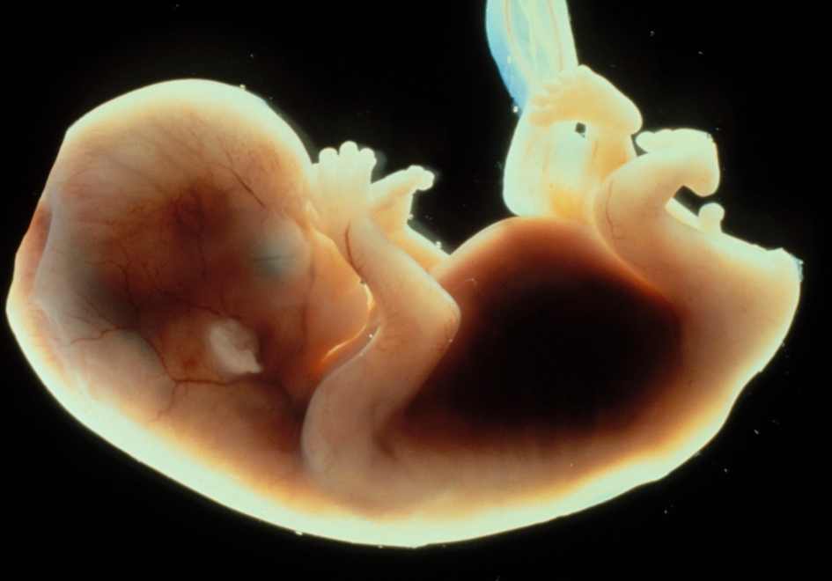
Ears are developing.
9-11 weeks after conception. Photo Credit: Science Photo Library
Notes:
9-11 weeks after conception, the circulatory, digestive, and urinary systems are all working.
The eyelids, eyes, and ears are developing, as seen in this image.
Knees, elbows, and ankles are working and moving around. Even though this motion can be seen on ultrasound, it is still too early for the mother to feel any kicks.

Slide 4
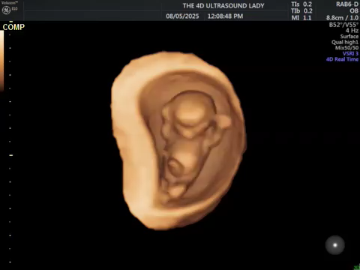
9 Week Pregnancy
Credit: 4 D Ultrasound Lady
Notes:
This is a powerful 19 second video of a 4 D ultrasound highlighting a pre-born person in the womb moving and kicking at 9 weeks. All the baby’s joints, including the knee, elbow, shoulder, ankle, and wrist joints, are working and allowing the baby to move about freely within the amniotic sac.

Slide 5
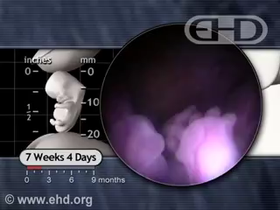

Credit: Endowment of Human Development
Notes:
This is an amazing 13-second video that showcases fetal eye development using real fetal imaging, offering a compelling visual insight into this stage of growth

Slide 6
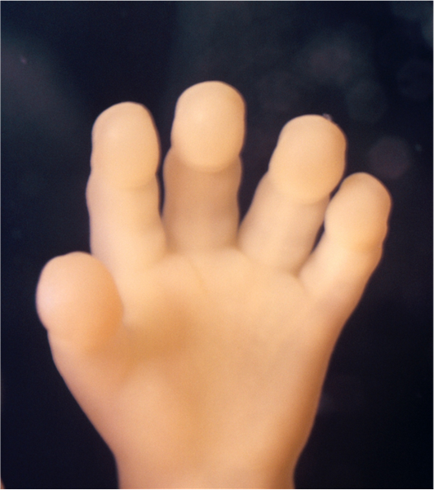
Fingerprints are forming.
3D Ultrasound of hand, 12 weeks after conception. Photo Credit: Science Photo Library
Notes:
10 weeks after conception, the arms, hands, fingers, feet, and toes are fully formed. They will continue to grow throughout the child’s life and into puberty.
At this stage, the pre-born baby begins opening and closing his or her fists and mouth, practicing both grasping and eating.
The fingerprints, fingernails, and toenails are all developing. These are the same fingerprints this person will carry for their entire life.
At the end of month 3, the pre-born person is about 2 ½ -3 inches long and the size of a plum.

Slide 7
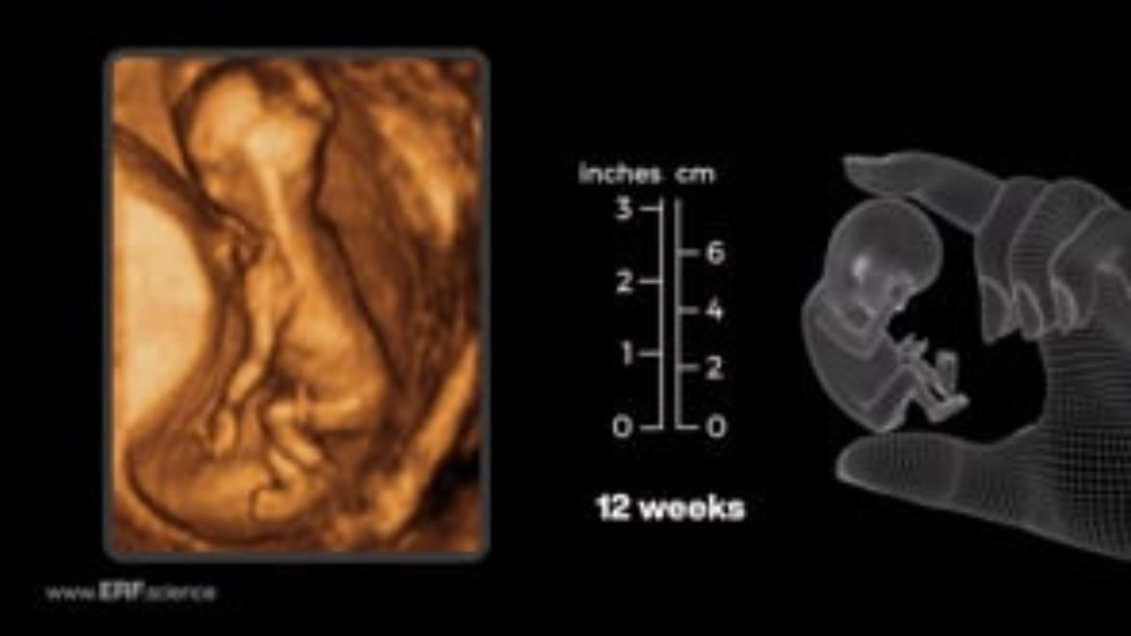
12 Weeks
12 Weeks
Credit: Education Resource Fund 12-week Video
Notes:
This is a 35 second video showing a pre-born human person at 12 weeks in the womb on 3D ultrasound and camera imaging. On the video, you can see the hands clearly – even the fingernails.

Slide 8

Credit: Smithsonian Channel
Notes:
This is an interesting 2 minute, 30 second video on how fingerprints develop in the womb.

Slide 9

Discussion Questions
Notes:
Teachers: Please refer to teaching guide for discussion questions.

Slide 10
Resources
Fetal Facts: Cleveland Clinic: https://my.clevelandclinic.org/health/articles/9699-first-trimester
Mayo Clinic Fetal Facts: https://www.mayoclinic.org/healthy-lifestyle/pregnancy-week-by-week/in-depth/prenatal-care/art-20045302
9 weeks after conception, Photo Credit: Lunar Caustic
9-11 weeks after conception, Photo Credit: Science Photo Library
10-week-old hand after conception, 12-week-old hand LMP, Photo Credit: Science Photo Library
The Endowment of Human Development, 7 weeks 4 days.
Smithsonian Channel, Where Do Fingerprints Come From? June 19, 2012. "YouTube". https://www.youtube.com/watch?v=qX6hFXHDmk4

