Slide 1

Month 4
Weeks 11-14 after Conception
Notes:
We are new entering into the second trimester. The second trimester spans from 11-26 weeks after conception. During this time, the pre-born person is also getting larger; therefore, women begin to show the physical signs of being pregnant.
In Month 4, development continues to occur in the key functions and systems, and the pre-born person begins to perform more typical human behaviors.

Slide 2
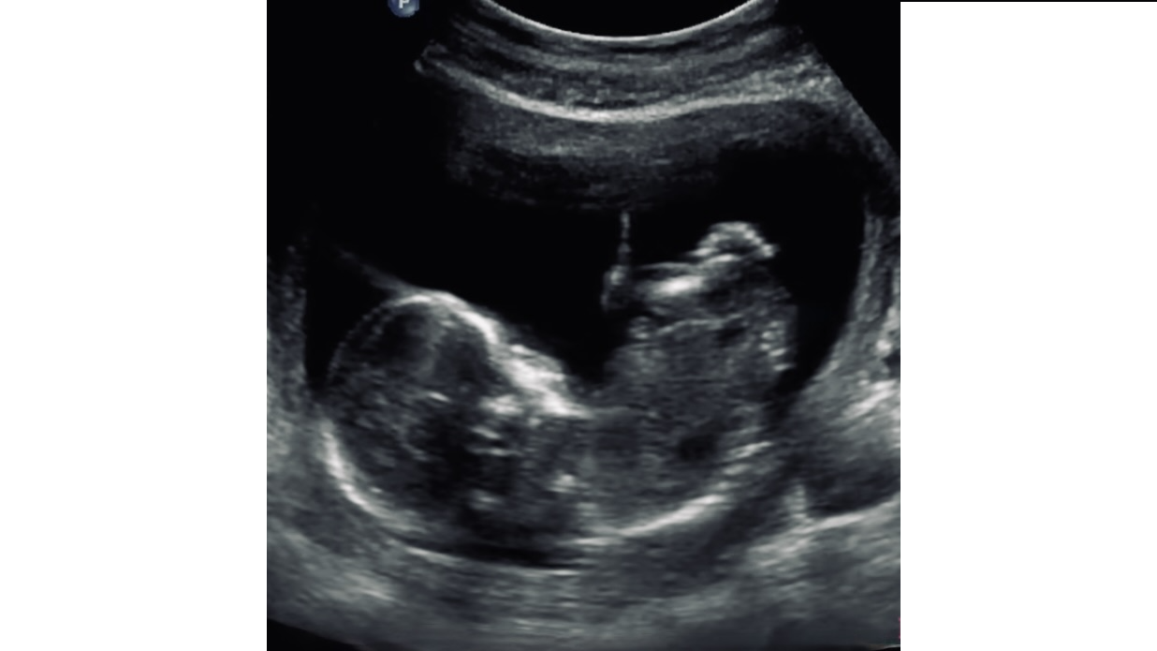

Thumb sucking occurs.
Foot
Head
Ultrasound, 13 weeks after conception. Photo Credit: Pregnancy Chat
Notes:
The pre-born person can make faces, suck his or her thumb and kick his or her feet.
Bones are hardening and can be seen on ultrasound, like this one. The brightest white areas on an ultrasound indicate the bones, the darkest areas indicate fluid.
Gender can be identified through a blood test at 10 weeks (hold up 10-week-old fetal model). It can also be identified through ultrasound sometimes as early as 14 weeks, but for sure by 16-20 weeks.
Gender can be identified through a blood test at 10 weeks. It can also be identified through ultrasound sometimes as early as 14 weeks, but for sure by 16-20 weeks.

Slide 3
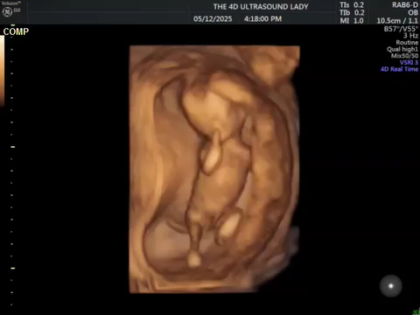
11 Weeks 2 Days
Credit: 4 D Ultrasound Lady
Notes:
This is is 4D ultrasound of an 11 week old pre-born person in the womb.

Slide 4
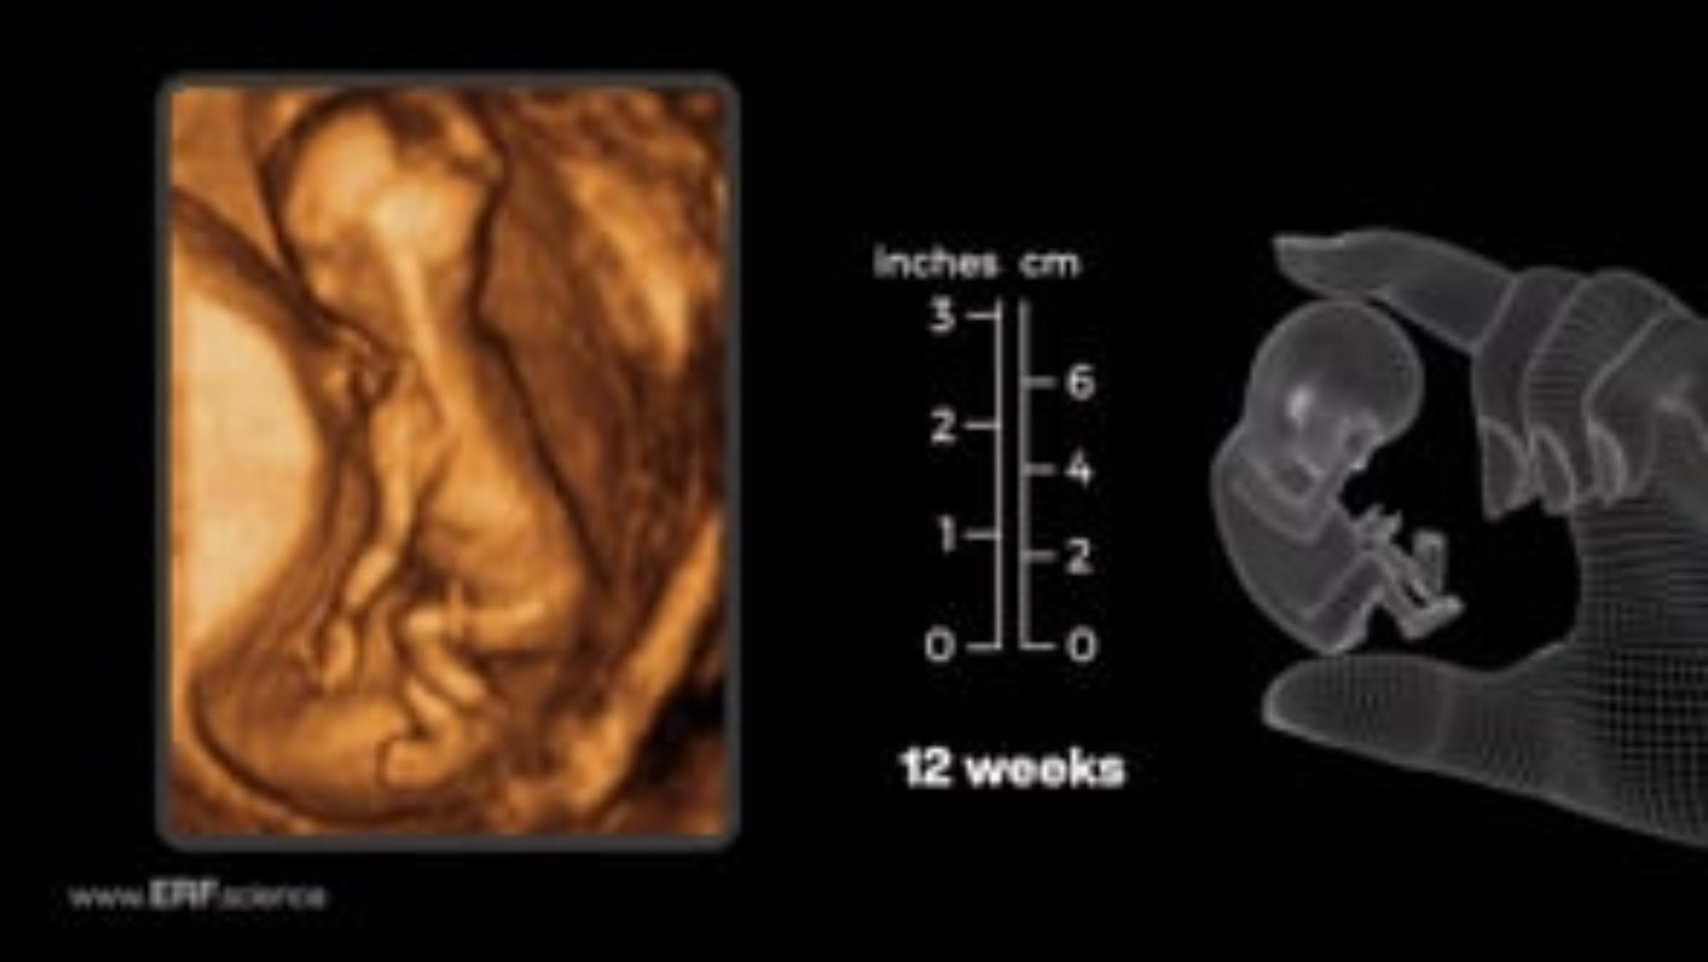
12 Weeks
Credit: Education Resource Fund 12-week Video
Notes:
The brain of a 12-week-old fetus develops 250,000 new neurons per minute. That is 15 million per hour. What an incredible rate of growth! (Hold up 12-week-old fetal model).
The brain of a 9-month fetus will have 1 billion neurons, the approximate number of stars in the Milky Way Galaxy.

Slide 5
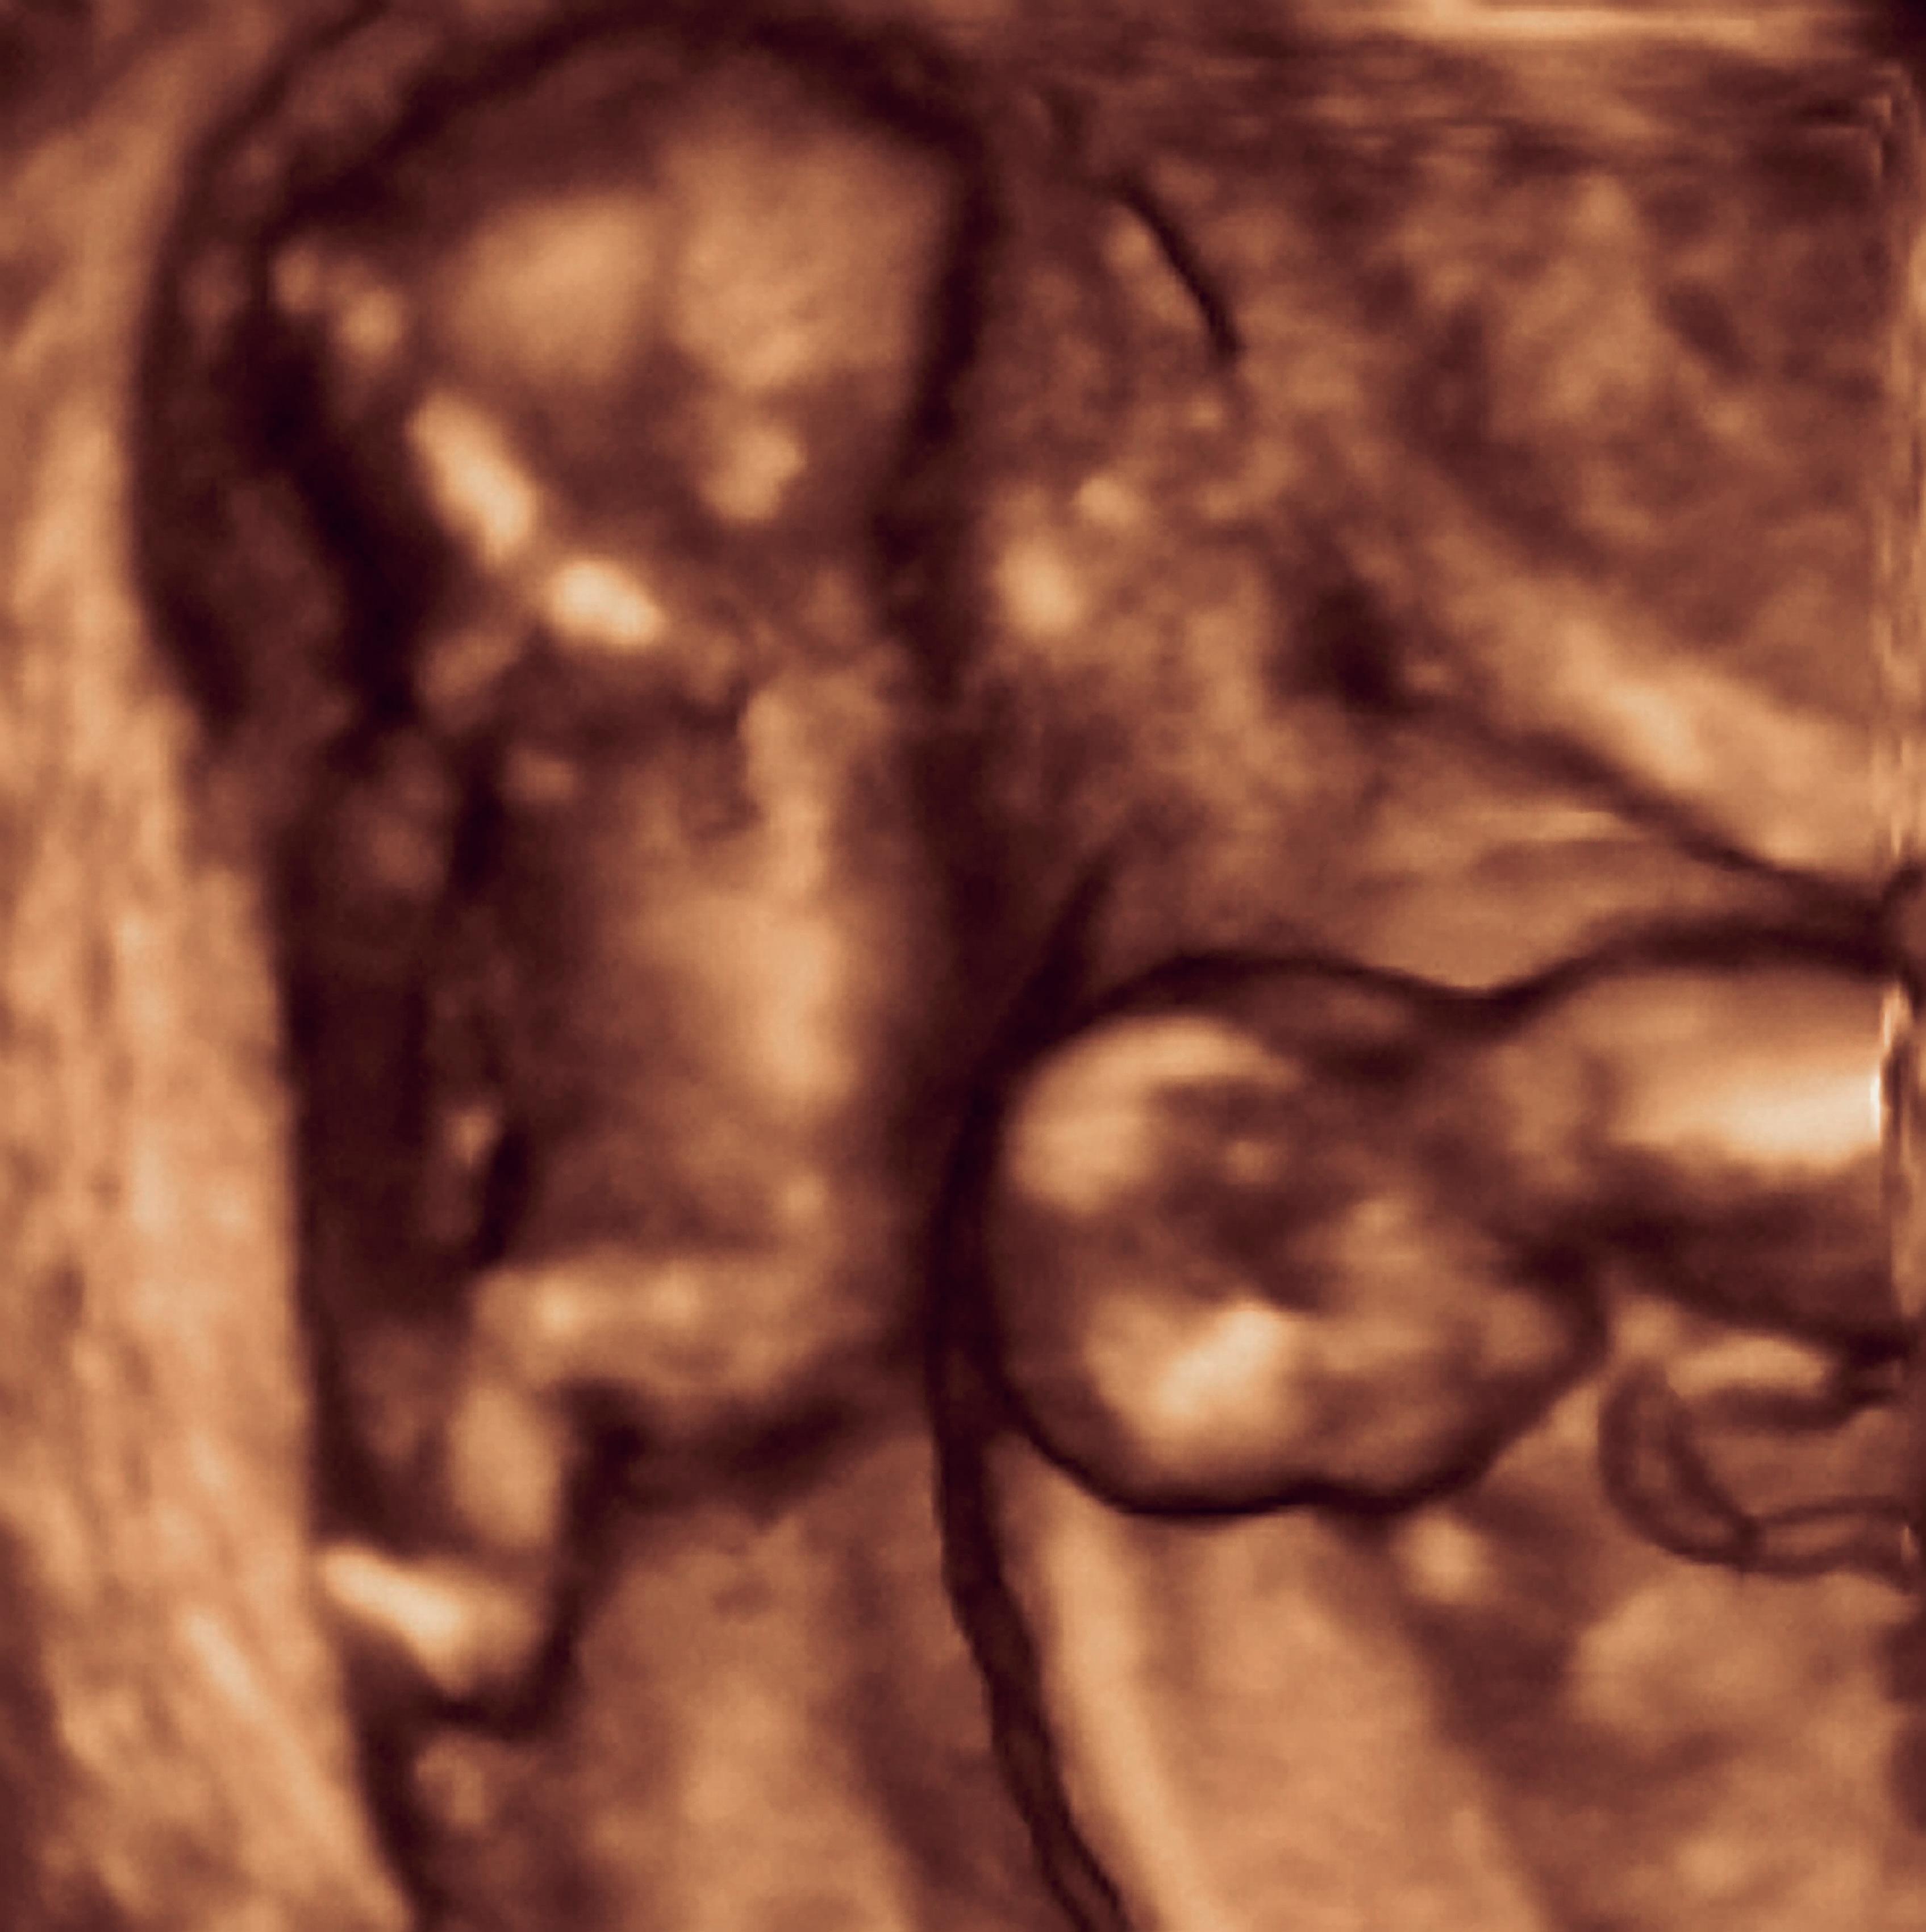
Flipping happens.
3D Ultrasound of Twins, 16 weeks after conception
Photo Credit: Science Photo Library
Notes:
The pre-born person can now flip, move sideways, and change positions, as indicated on this 3D ultrasound of twins.
The pre-born person inhales and exhales small amounts of amniotic fluid to practice breathing. This helps strengthen muscles and develop lungs.
By the end of the month, eyes are still closed, but the pre-born person can perceive light and make squinting facial expressions.

Slide 6
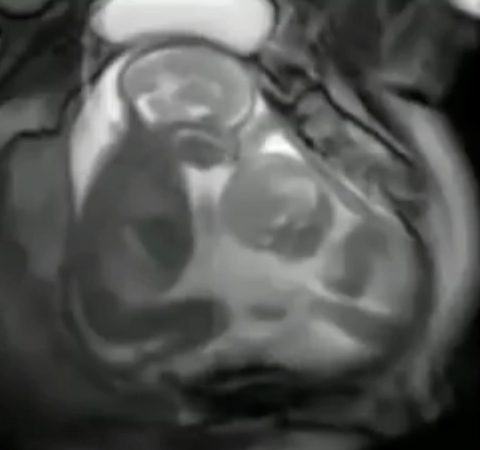
MRI of Twins in the Womb
Notes:
This short video of an MRI of twins shows them moving and swallowing in the womb.
What do you think that this video might show about the possible temperaments and personalities of these two different humans?

Slide 7
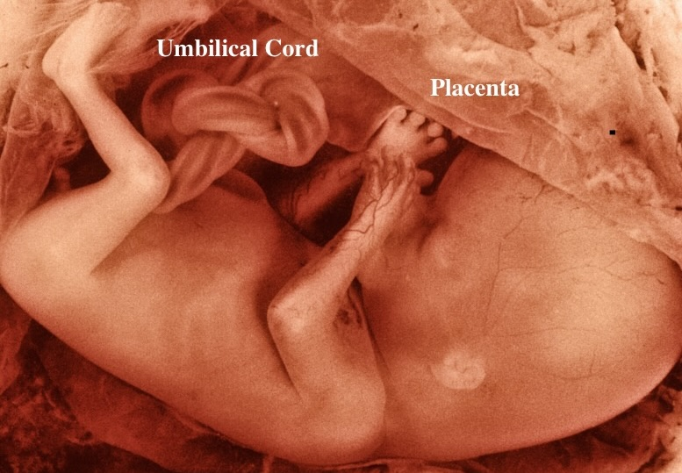
Hair is growing.
13 weeks after conception
Photo Credit: Science Photo Library
Notes:
Hair patterns are forming as fine hair begins to grow.
Skin is thin and transparent but getting thicker.
Vocal cords are forming, preparing for future talking and singing.
At the end of month 4, the pre-born person is about 5 inches long - the size of a large avocado.

Slide 8
Discussion Questions
Notes:
Teachers:
Please refer to the teaching manual for discussion questions.

Slide 9
Resources
Cleveland Clinic, Retrieved: June, 2025, https://my.clevelandclinic.org/health/articles/7247-fetal-development-stages-of-growth
Mayo Clinic, Mayo Clinic Staff (Butler Tobah, Y., M.D., Marnach, M. M.D., & Wick, M., M.D., P.h.D.), Healthy Lifestyle: Pregnancy Week by Week (n.d.), Retrieved August 20, 2020 from https://www.mayoclinic.org/healthy-lifestyle/pregnancy-week-by-week/basics/healthy-pregnancy/hlv-20049471
Ultrasound Image, 14 weeks from conception/16 weeks from LMP, Pregnancychat.com
Photo Source: 14 -15 week old fetus after conception, 16 -17 week old pre-born person LMP, Lunar Caustic.
Photo Source: 3D ultrasound of twins, Science Photo Library
https://www.youtube.com/shorts/hhDLM4iQH70
YouTube: Imagine Study "Fetal Eye Movement" https://www.youtube.com/watch?v=xrr6plHNnqQ

Slide 10
Resources
Charlotte Lozier, The Voyage of Life, 'Eye Formation": https://lozierinstitute.org/dive-deeper/eye-formation/
Charlotte Lozier, The Voyage of Life, "Hearing in the Womb", https://lozierinstitute.org/dive-deeper/hearing-in-the-womb/
Moore, Keith L, TVN Persaud, and Mark G. Torchia. The Developing Human, Clinically Oriented Embryology. 10th ed. Philadelphia: Elsevier, 2016.
Hatem A. Tawfik et al., “Embryologic and Fetal Development of the Human Eyelid,” Ophthalmic Plastic and Reconstructive Surgery 32, no. 6 (November 2016): 407–14, https://doi.org/10.1097/IOP.0000000000000702.
Horimoto et al., “Fetal Eye Movements,” Ultrasound in Obstetrics & Gynecology 3, no. 5 (1993): 362–69, https://doi.org/10.1046/j.1469-0705.1993.03050362.x.
Birnholz, J. C. (1981). The development of human fetal eye movement patterns. Science, 213(4508), 679-681. DOI:10.1126/science.7256272.
Ricci, D., Romeo, D. M., Serrao, F., Gallini, F., Leone, D., Longo, M., … Mercuri, E. (2010). Early assessment of visual function in preterm infants: How early is early? Early Human Development, 86(1), 29–33. https://doi.org/10.1016/j.earlhumdev.2009.11.0.
Education Resouces Fund: https://erf.science/#short-videos 11 & 12 weeks

