Slide 1

Month 5
Weeks 15-18 after Conception
Notes:
During month 5, exciting things begin to happen – more movement, development and a key sensory ability kicks in.

Slide 2
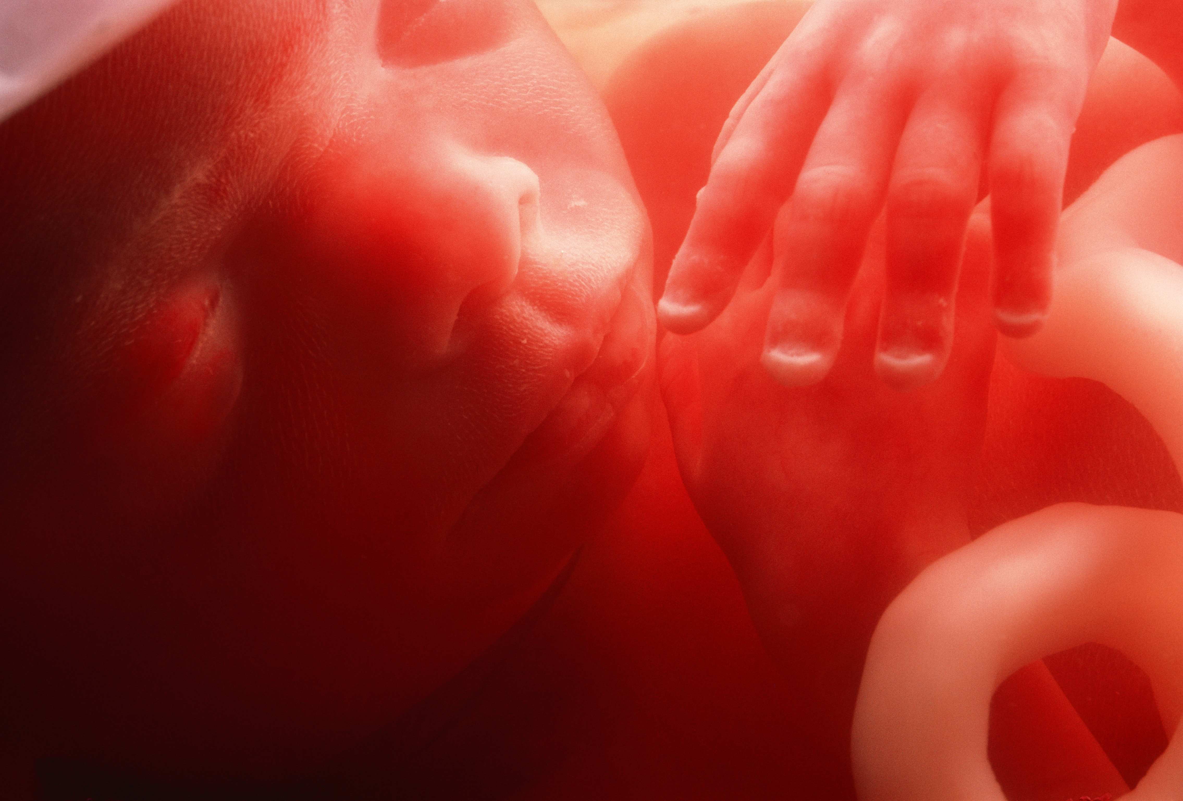

Hiccups occur.
18 weeks after conception
Photo Credit: Science Photo Library
Notes:
The pre-born person can hiccup.
Most moms begin to feel movement – which feels like a flutter – a sensation called “quickening”. By the end of the month, the sensations increase with most moms feeling the hiccups, light kicks and punches as the pre-born person becomes more active - rolling and flipping in the womb.
A pre-born person can feel full pain and sensations at this age, as well.

Slide 3
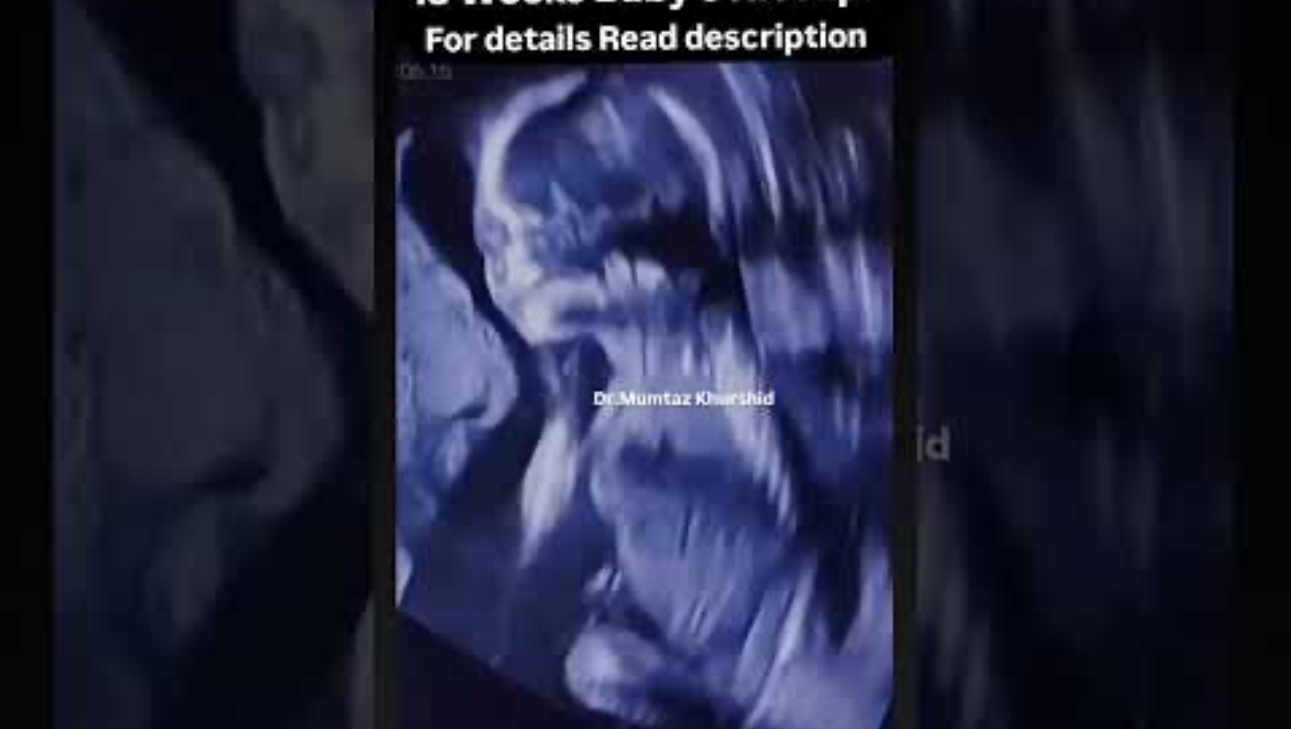
18 Weeks Pregnancy Showing Fetal Hiccups
18 Weeks Pregnancy Showing Fetal Hiccups
Video Credit: Dr. Mumtaz Khurshid
Notes:
This is an ultrasound video of a pre-born person with hiccups.

Slide 4
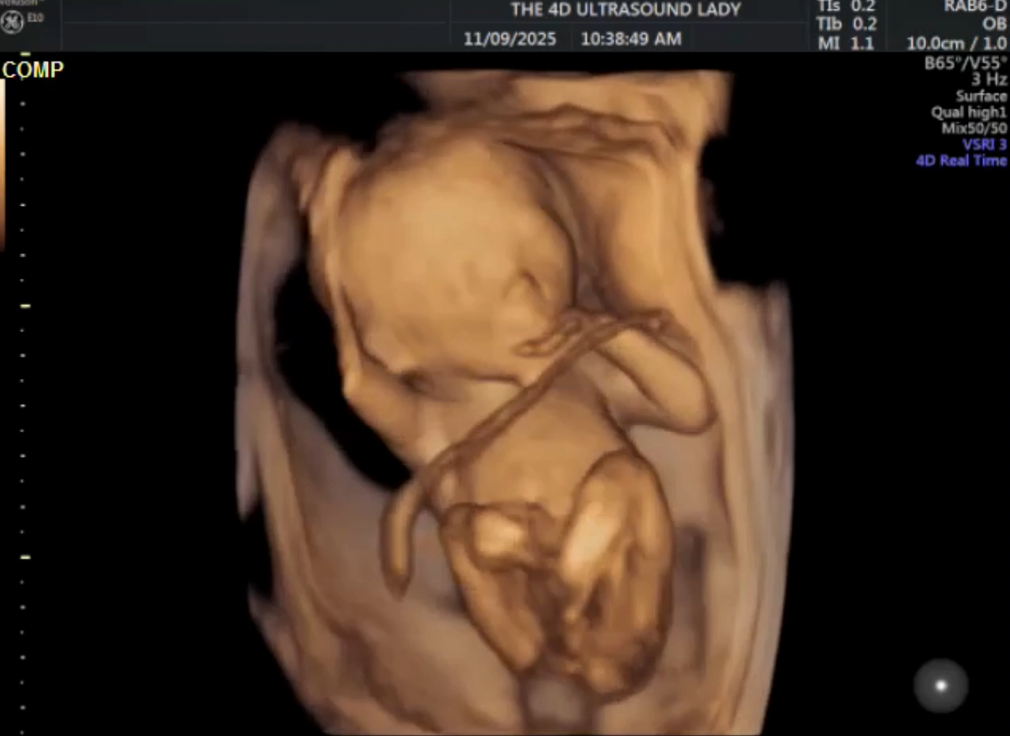
16 weeks from Conception
Credit: 4D Ultrasound Lady
Notes:
Notes: This is a 4D scan of a 16-17-week-old pre-born person who is very active in the womb (hold up 16 week old model).The pre-born person may move in response to sound, pressure on the mother’s abdomen, or changes in the mother’s position.

Slide 5
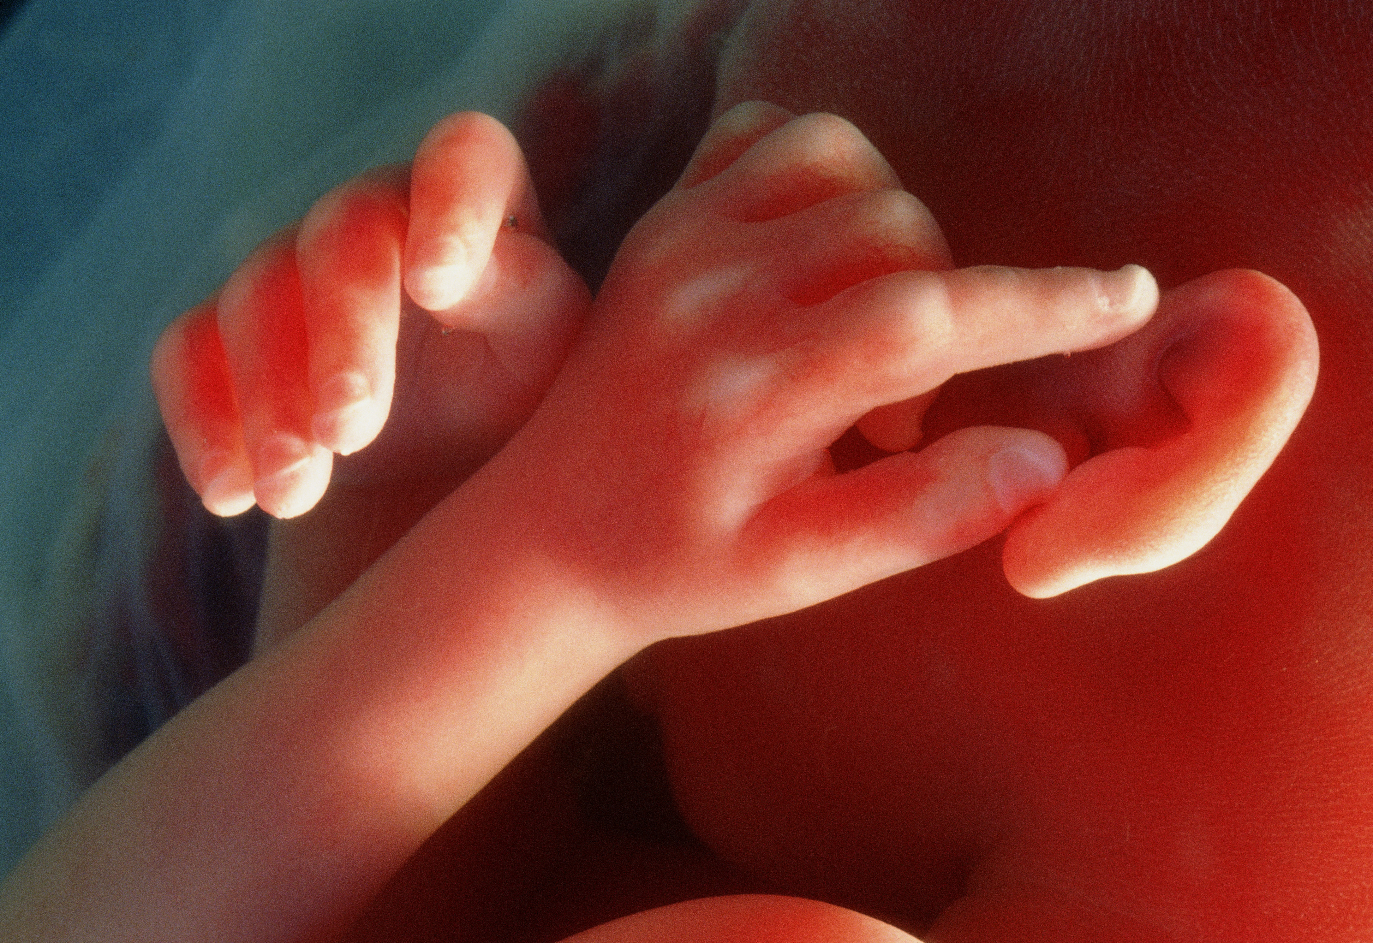
Hearing begins.
20 weeks after conception​
Photo Credit: Science Photo Library
Notes:
The pre-born person begins to hear mom's heartbeat, stomach rumbling.
The pre-born has his or her own solid set of fingerprints and fingernails now.
The pre-born person's skin is covered by a greasy, cheese-like coating called vernix. This helps protect the skin from chapping and hardening that can occur due to constant contact with the amniotic fluid.
Lanugo is also present. Lanugo is a peach fuzz-like hair-covering over the skin that provides extra protection and warmth.

Slide 6
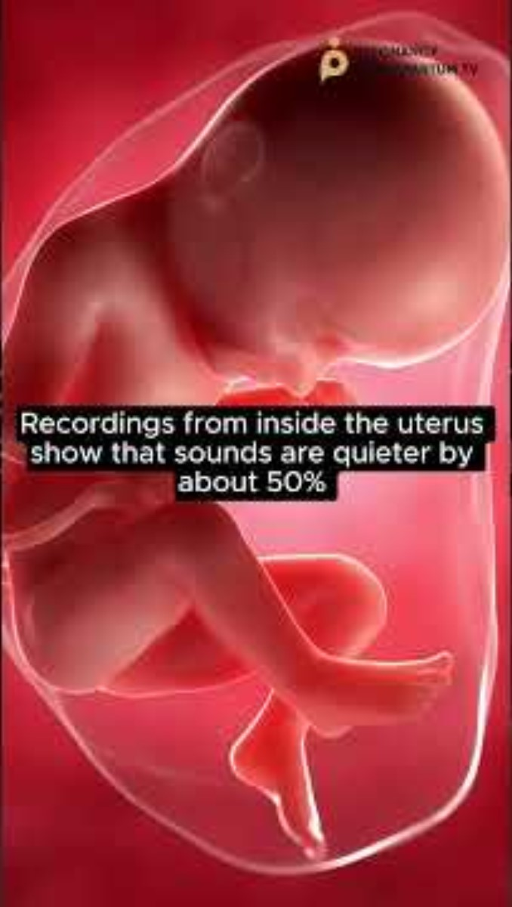
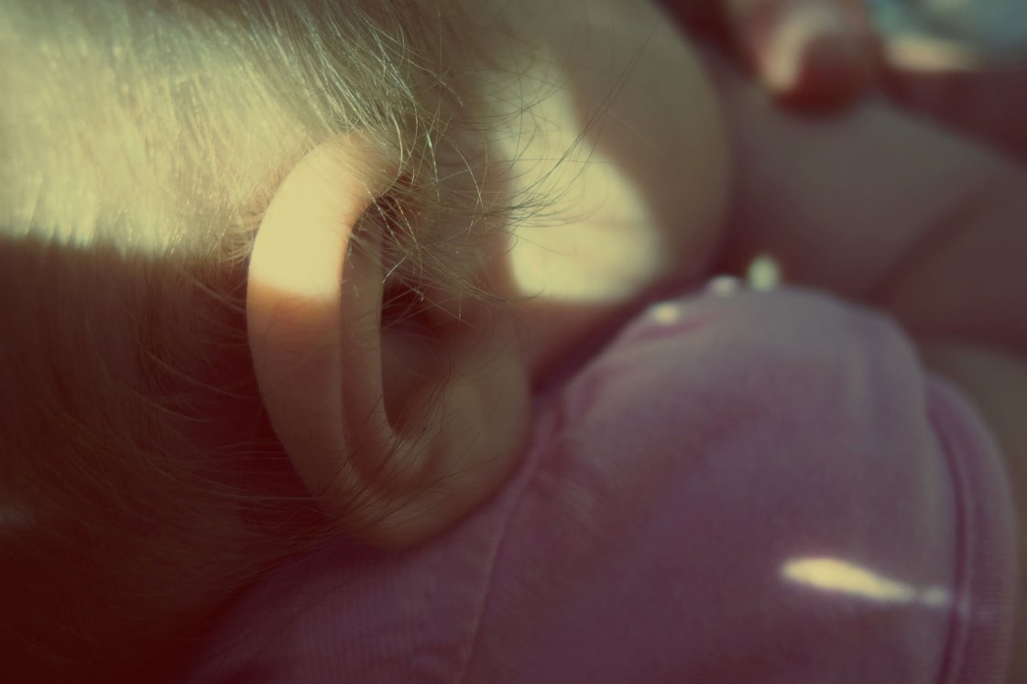
What Baby Hears In The Womb
Notes:
Notes: While the cochlea, middle ear, and outer ear all start forming around 7 weeks gestation, these structures take many more weeks to mature and send signals to the brain. The earliest evidence of a fetus responding to sound is at 16 weeks. The pre-born person begins to hear mom’s heartbeat, stomach rumbling, and breathing.

Slide 7
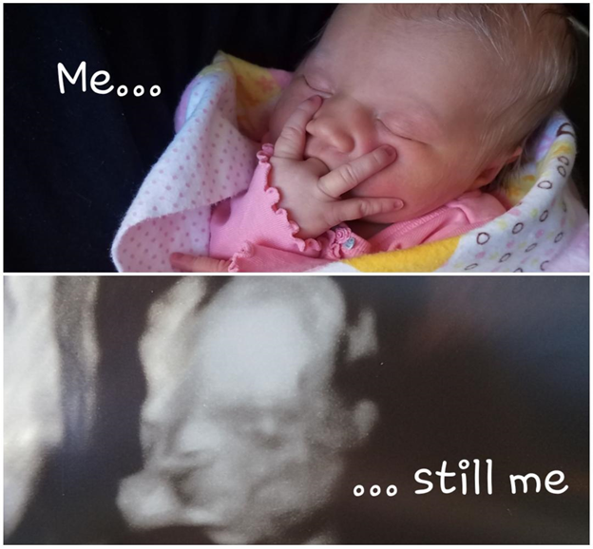
Habits are formed.
Newborn baby Olivia,
Photo Credit: Natalie Voithofer
20-week ultrasound of Olivia,
Photo Credit: Natalie Voithofer
Notes:
A diagnostic ultrasound is typically performed at this point in the pre-born person’s development in order to determine overall health and growth. This image shows a 3-D ultrasound of a pre-born person, named Olivia.
Habits are formed in womb as shown comparing this ultrasound with the actual photo of Olivia after birth. Olivia was sucking her hand in the womb in the same way that she continued to suck her hand after birth as shown by these photos.
At the end of month 5, the pre-born person is now about 7 inches long and weighs about 1 pound—the size of a zucchini.

Slide 8
Discussion Questions
Notes:
Teachers:
Please see the teaching manual for discusson questions.

Slide 9
Resources
Cleveland Clinic, Retrieved: June, 2025, https://my.clevelandclinic.org/health/articles/7247-fetal-development-stages-of-growth
Mayo Clinic, Mayo Clinic Staff (Butler Tobah, Y., M.D., Marnach, M. M.D., & Wick, M., M.D., P.h.D.), Healthy Lifestyle: Pregnancy Week by Week (n.d.), Retrieved August 20, 2020 from https://www.mayoclinic.org/healthy-lifestyle/pregnancy-week-by-week/basics/healthy-pregnancy/hlv-20049471
Pregnancy Chat and Postpartum TV: What baby's really Hear in the Womb, https://www.youtube.com/shorts/hhDLM4iQH70
Ultrasound Image, 19 weeks from conception/21 weeks from LMP, Pregnancychat.com
Photo Source: 20-week old pre-born person touching ear, Science Photo Library.
Photo Source: 20-week-old pre-born person, Science Photo Library.
Photo Source: 3D ultrasound image of Olivia, Natalie Voithofer
Photo Source : Newborn baby Olivia, Natalie Voithofer
Video Source: 18 Week Pregnancy Showing Fetal Hiccups, Dr. Mumtaz Khurshid. Feb 21, 2025, https://www.youtube.com/watch?v=kJrRw6kbnW4
Video Source: 16 Week from Conception [18 weeks LMP], 4D Ultrasound Lady, November 21, 2025, Facebook.
Steven Christie, MRI of 20 week Twins. https://speakingfortheunborn.com/baby-videos/

