Slide 1

Month 6
Weeks 19-22 after Conception
Notes:
In this month of pregnancy, we will discover more about what the pre-born person can hear and respond to with movement and reaction.

Slide 2
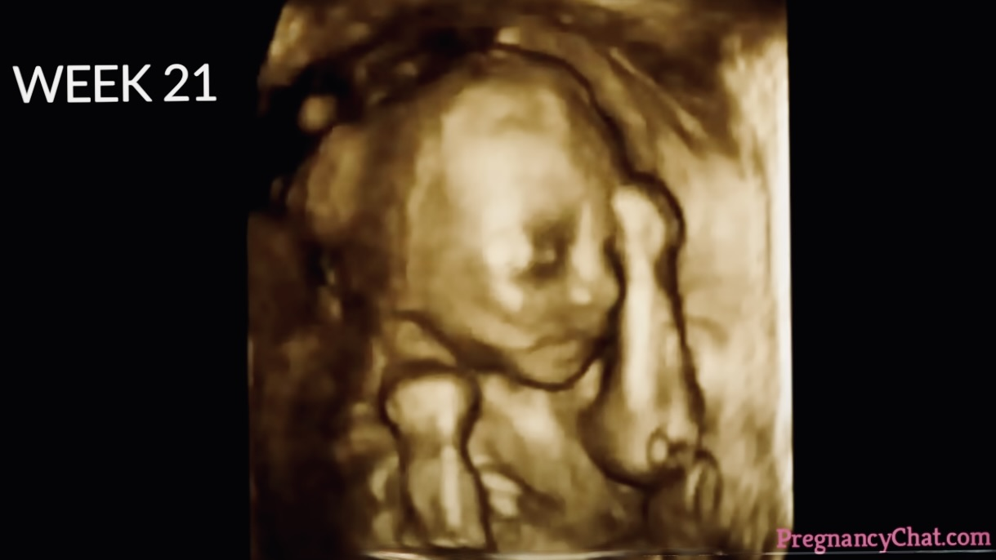

Sleep and wake cycles occur.
3D Ultrasound, 19 weeks after conception ​Photo Credit: Pregnancy Chat
Notes:
This is a 3D ultrasound of a pre-born person at 19 weeks post conception.
At this age and stage, the pre-born person has regular sleep and wake cycles.
Eyebrows and hair are visible.
Eyelids begin to part and regular, jerky movements of the eyes are noticed.

Slide 3
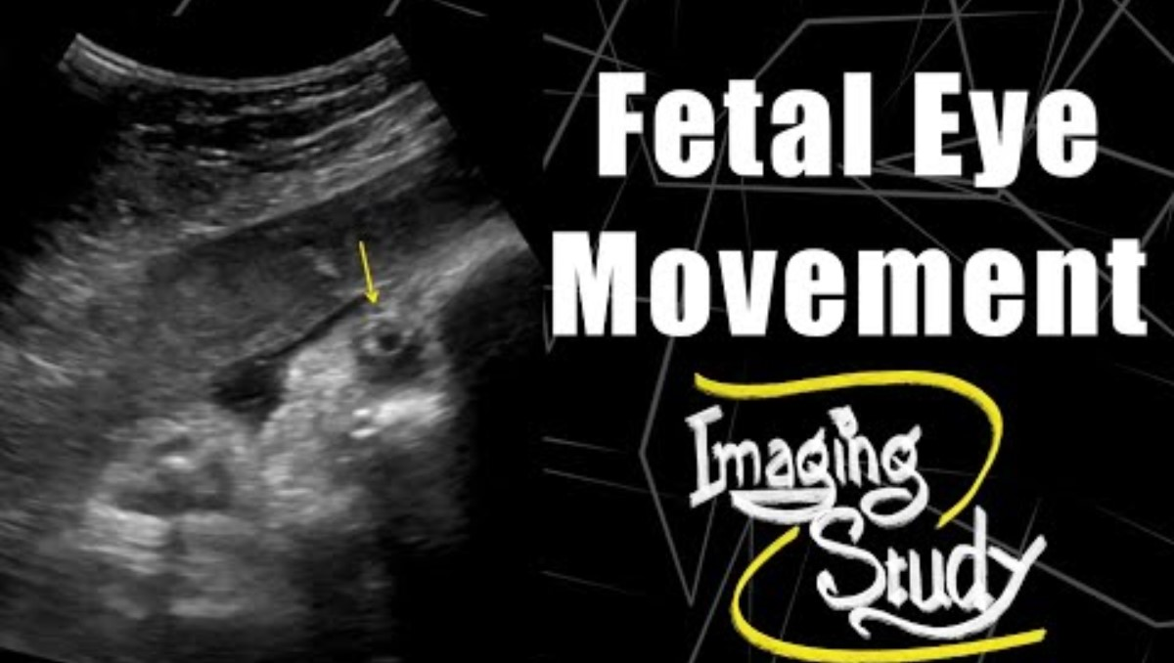
Fetal Eye Movement
Notes:
This video shows the pre-born person’s pupils moving inside the womb. Watch closely.

Slide 4
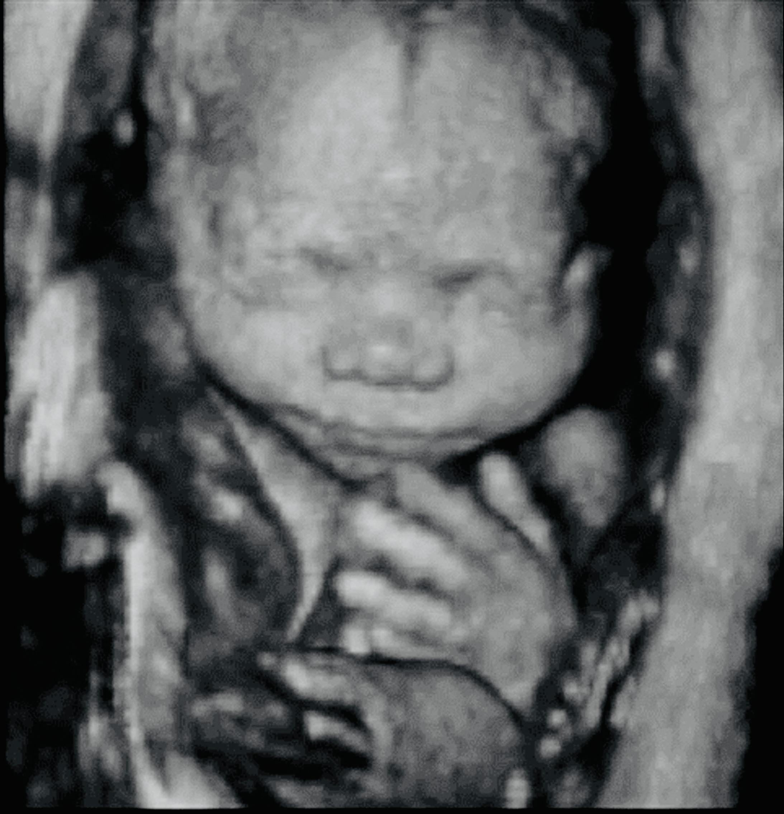
Music can cause reactions.
3D Ultrasound, 24 weeks after conception ​Photo Credit: Science Photo Library
Notes:
This is another 3D ultrasound of a pre-born person.
The pre-born person can reach for objects now, like the umbilical cord or his or her ears.
The pre-born person is gaining more body fat which helps the skin look less wrinkled and fuller.
The pre-born person can now respond to both internal and external sound – like loud music- indicated by his or her movements or by an increase in pulse as seen on ultrasound.

Slide 5
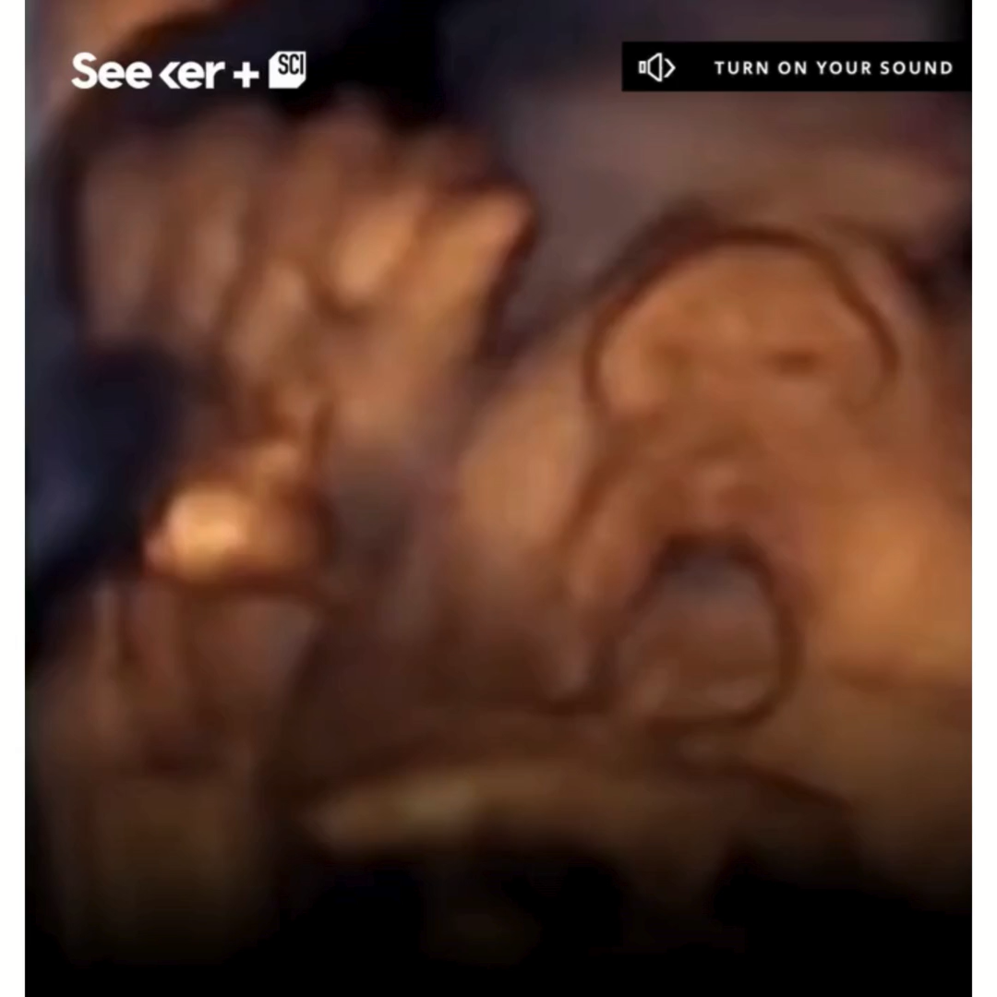
“Here’s what kind of music babies love best”. Credit: Insitut Marques/Seeker by The Verge via Facebook
Notes:
This is a short video of the pre-born person reacting and responding to music.

Slide 6
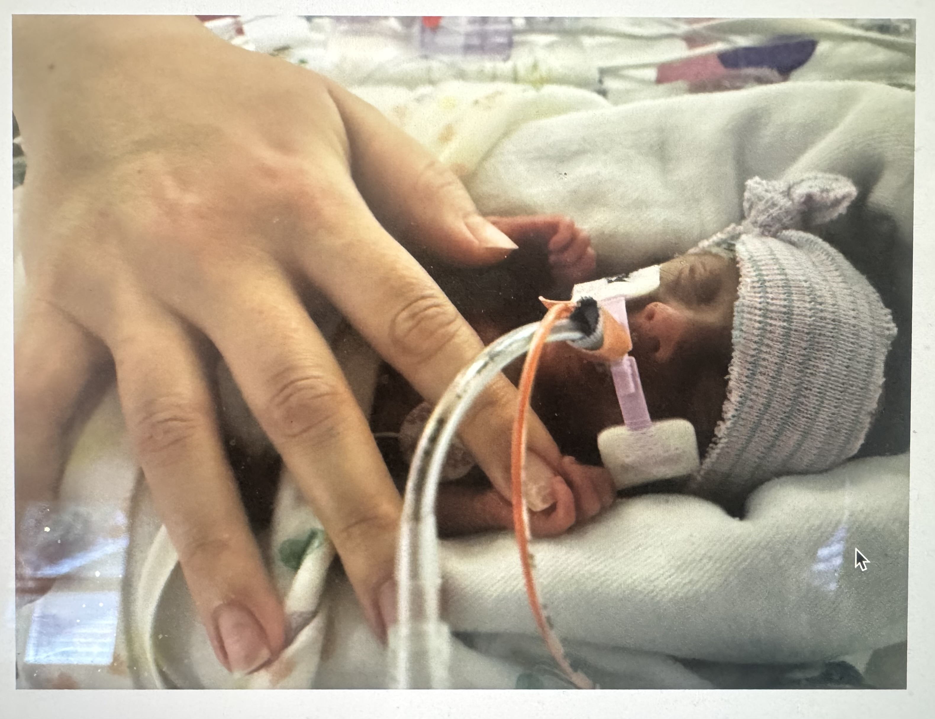
Baby can survive if born.
Born early, 23 weeks after conception​. Photo Credit: Stanford Medical Children's Hospital
Notes:
This is a photo of a person- born early at just 23 weeks post conception (hold up the 22 week old fetal model).
At this age and stage, the pre-born person’s lungs start to make surfactant, a substance that supports healthy breathing and allows the air sacs in the lungs to inflate and keeps the lungs from collapsing and sticking together when they deflate.
If born prematurely, the pre-born person may survive with intensive medical care.
At the end of month 6, the pre-born person is about 12 inches long and weighs about 2 pounds – about the size of a butternut squash.

Slide 7

“Iowa Boy Born at 21 Weeks Now the World’s Most Premature Baby”. Credit: WQAD News 8
Notes:
Following is a 1-minute video of a boy from Iowa who was born at 21 weeks and survived. He is the world's most premature baby who lived.

Slide 8
Discussion Questions
Notes:
Teachers:
Please refer to the teaching manual for discussion questions.

Slide 9
Resources
Cleveland Clinic, Retrieved: June, 2025, https://my.clevelandclinic.org/health/articles/7247-fetal-development-stages-of-growth
Mayo Clinic, Mayo Clinic Staff (Butler Tobah, Y., M.D., Marnach, M. M.D., & Wick, M., M.D., P.h.D.), Healthy Lifestyle: Pregnancy Week by Week (n.d.), Retrieved August 20, 2020 from https://www.mayoclinic.org/healthy-lifestyle/pregnancy-week-by-week/basics/healthy-pregnancy/hlv-20049471
Hearing in the Womb, Charlotte Lozier Institute, 2023
Ultrasound Image, 19 weeks from conception/21 weeks from LMP, Pregnancychat.com
Photo Source: 24-week-old LMP 3D ultrasound, Science Photo Library
Photo Source: Baby Girl Born At 23 Weeks Thriving Despite 1 Percent Chance Of Living, SWNS.com
Photo Source: Meet a Feister 23 Weeker, Stanford Medical Children’s Hospital.
Video: Iowa Boy Born at 21 Weeks Now the World’s Most Premature Baby, WQAD News 8. https://www.youtube.com/watch?v=DRnsrjGgolg. July 23, 2025
Video: Seeker By the Verge/Institut Marques. (2019). Here’s what kind of music babies love best. Facebook. https://www.facebook.com/share/v/1DHQM9n3RM/?mibextid=wwXIfr

