Slide 1

Month 7
Weeks 23-26 after Conception
Notes:
In month 7, the pre-born person and all of his or her organs continue to develop - with new incredible capacities that we will learn about here.

Slide 2
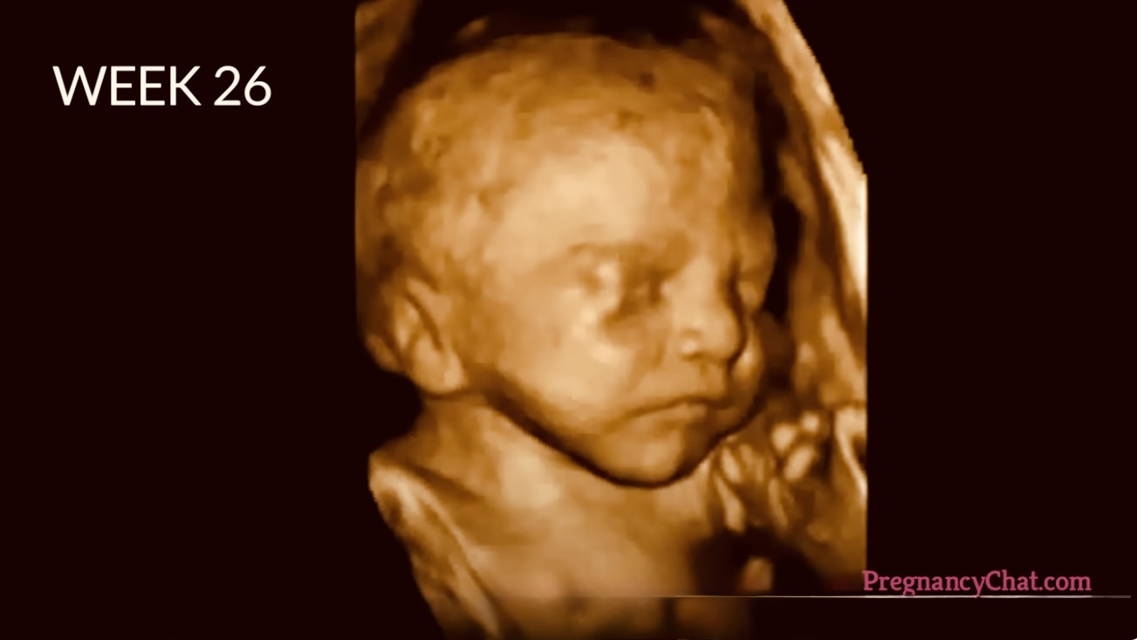

Blinking occurs.
3D Ultrasound, 26 weeks after conception
Photo Credit: Science Photo Library​
Notes:
This is a 3D ultrasound image of a pre-born person, 26 weeks after conception (hold up 26-week old model).
The pre-born person can blink and has eye lashes.
The pre-born person has melanin, the substance that gives skin and eyes their color.
The pre-born person can respond to stimuli – including sound, pain, and light – turning his or her head toward or away from bright light, which has been seen through ultrasound.

Slide 3

Mom’s Voice Inspires Learning in the Womb — YouTube
Source: UF Health (2014)
Notes:
This is a 2-minute video explaining the importance of the mother’s voice to a pre-born person in their learning and memorization. This video shows how they respond to the sound of the mother's voice and to reading.

Slide 4
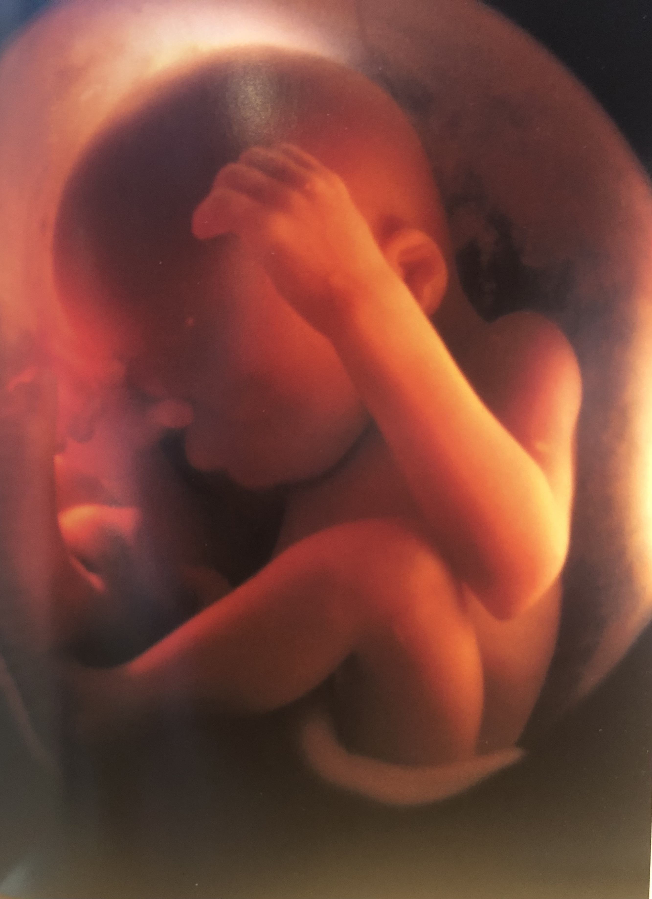
Dreaming is possible.
26 weeks after conception Photo Credit: Pregnancy Chat
Notes:
This is an image of a 26-week-old preborn person in the womb.
The pre-born person at this age and stage is gaining weight quickly, adding body fat that will help with warmth and protection after birth.
The pre-born person at about 28-weeks-old experiences REM or Rapid Eye Movement during sleep cycles. REM occurs during our deepest periods of sleep. Our pupils go back and forth quickly, while our eyes are closed, integrating both the right sides and left sides of our brains and our experiences. During this rapid eye movement, we dream. Because of this, scientists presume that the pre-born person is dreaming in some capacity as well. What do you think a pre-born person would dream about (their dreams would only involve their personal experiences)?

Slide 5
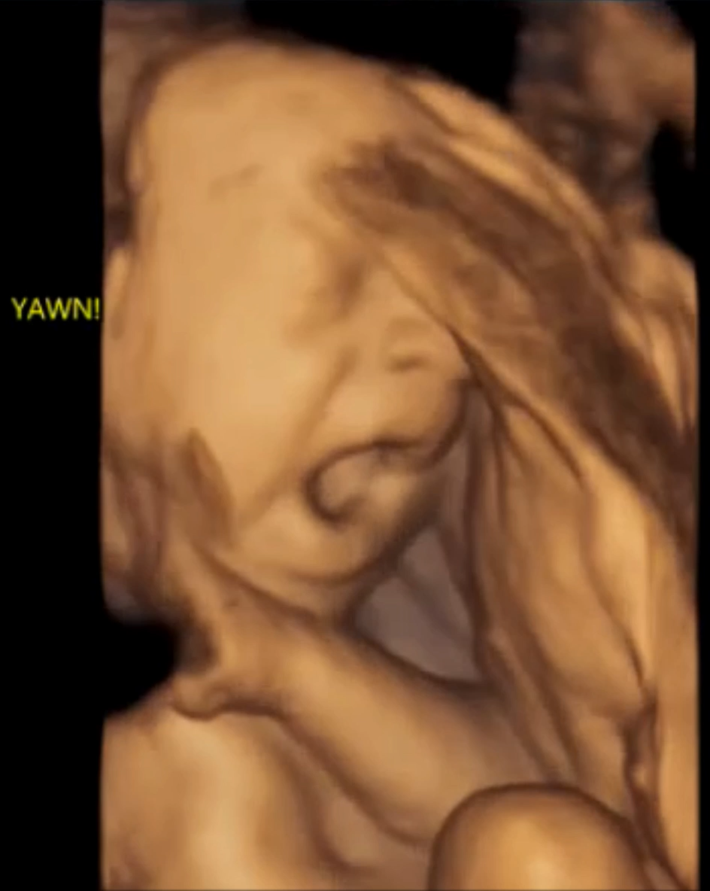
26 weeks from conception (28 LMP)– The Sweetest Yawn
Video credit: 4D Ultrasound Lady - Facebook
Notes:
Babies have regular sleep and wake cycles at this age and stage. This is a short video clip of a pre-born person yawning or opening his or her mouth wide in the womb. (26 weeks from conception).

Slide 6
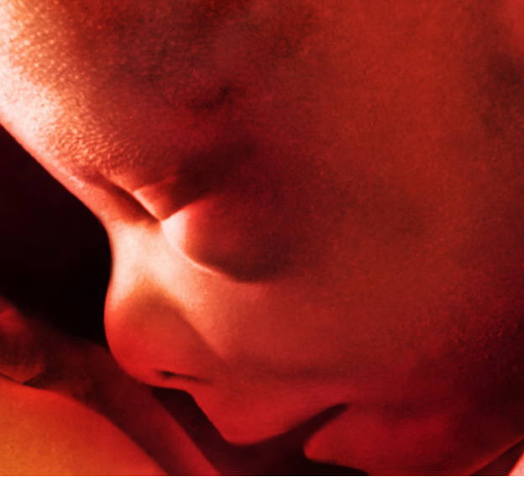
Legs kick powerfully.
28 weeks after conception. Photo Credit: Science Photo Library
Notes:
Kicks and jabs feel like strong pokes now to Mom because the pre-born person is getting bigger and filling up the amniotic sac.
The pre-born person can control his or her own body heat now.
The pre-born person may begin turning his or her head down in the uterus to get ready for birth.
At the end of month 7, the pre-born person is about 14 inches long and weighs about 3 pounds – about the size of a pineapple.

Slide 7
Discussion Questions
Notes:
Teachers:
Please refer to the teaching manual for discussion questions.

Slide 8
Resources
Cleveland Clinic, Retrieved: June, 2025, https://my.clevelandclinic.org/health/articles/7247-fetal-development-stages-of-growth
Mayo Clinic, Mayo Clinic Staff (Butler Tobah, Y., M.D., Marnach, M. M.D., & Wick, M., M.D., P.h.D.), Healthy Lifestyle: Pregnancy Week by Week (n.d.), Retrieved August 20, 2020 from https://www.mayoclinic.org/healthy-lifestyle/pregnancy-week-by-week/basics/healthy-pregnancy/hlv-20049471
Photo Credit: 3D ultrasound of 26- week-old fetus, Pregnancy Chat, pregnancychat.com
Photo Credit: 27-week-old LMP, Science Photo Library
Photo Credit: 28-week-old LMP, Science Photo Library
UF Health. (2014, July 22). Mom’s Voice Inspires Learning in the Womb [Video]. YouTube. https://www.youtube.com/watch?v=5Hb3hRaKkks
The4DUltrasoundLady. (2025, September 29). 28 Weeks (LMP) – The Sweetest Yawn [Video]. https://www.facebook.com/The4DUltrasoundLady/videos/1125741106203486

