Slide 1

Month 8
Weeks 27-30 after Conception
Notes:
We are now in the third trimester of pregnancy – the final stage where great growth and weight gain occur.
During month 8, the pre-born person continues to fatten up, and all organs are fully formed except for the brain and lungs. The lungs are the last organ to fully develop. This is why when a baby is born a month premature, sometimes they are put on a ventilator- because their lungs are not fully developed. Does anyone have experience with this?

Slide 2
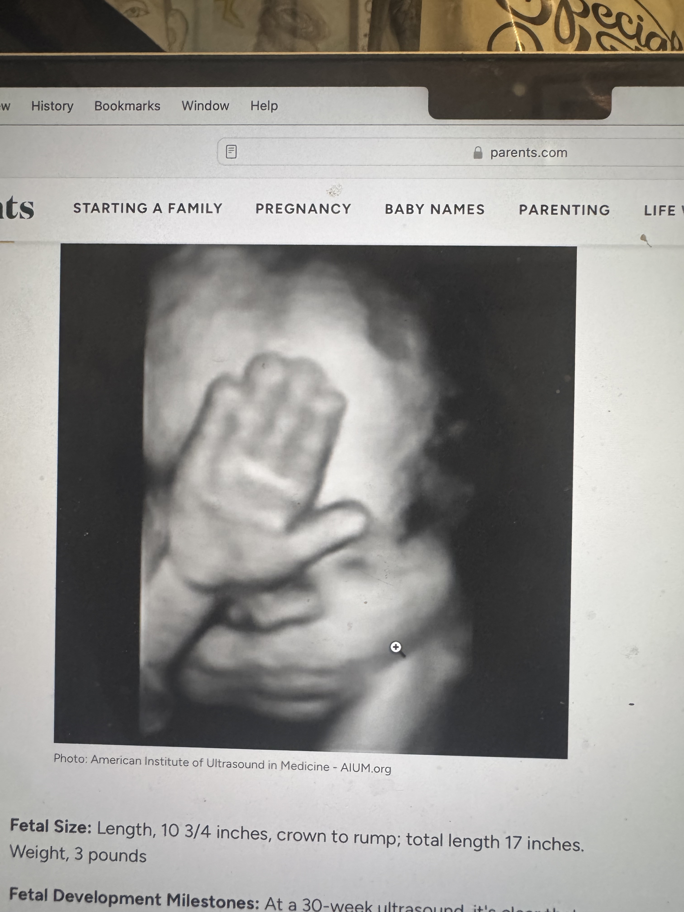

Eyes can open and shut.
3D Ultrasound, 28 weeks after conception.
Photo Credit: American Institute of Ultrasound in Medicine
Notes:
At this age and stage, the hearing is fully developed with the pre-born person hearing a wide range of sounds and frequencies.
The brain is growing rapidly, can process more information and respond directly to more stimuli – including light. Bright light can pentrate the womb. Although we do not know for sure, it appears that this pre-born person may be responding to bright light through this 3D ultrasound image.
The pre-born person's eyes can open and shut at this age and stage as well.

Slide 3
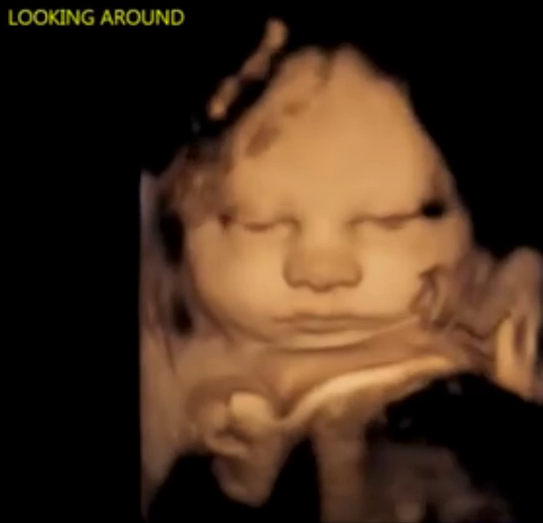
Credit: 4D Ultrasound Lady
Notes:
This is a short video clip of a pre-born person opening their eyes and looking around in the womb.

Slide 4
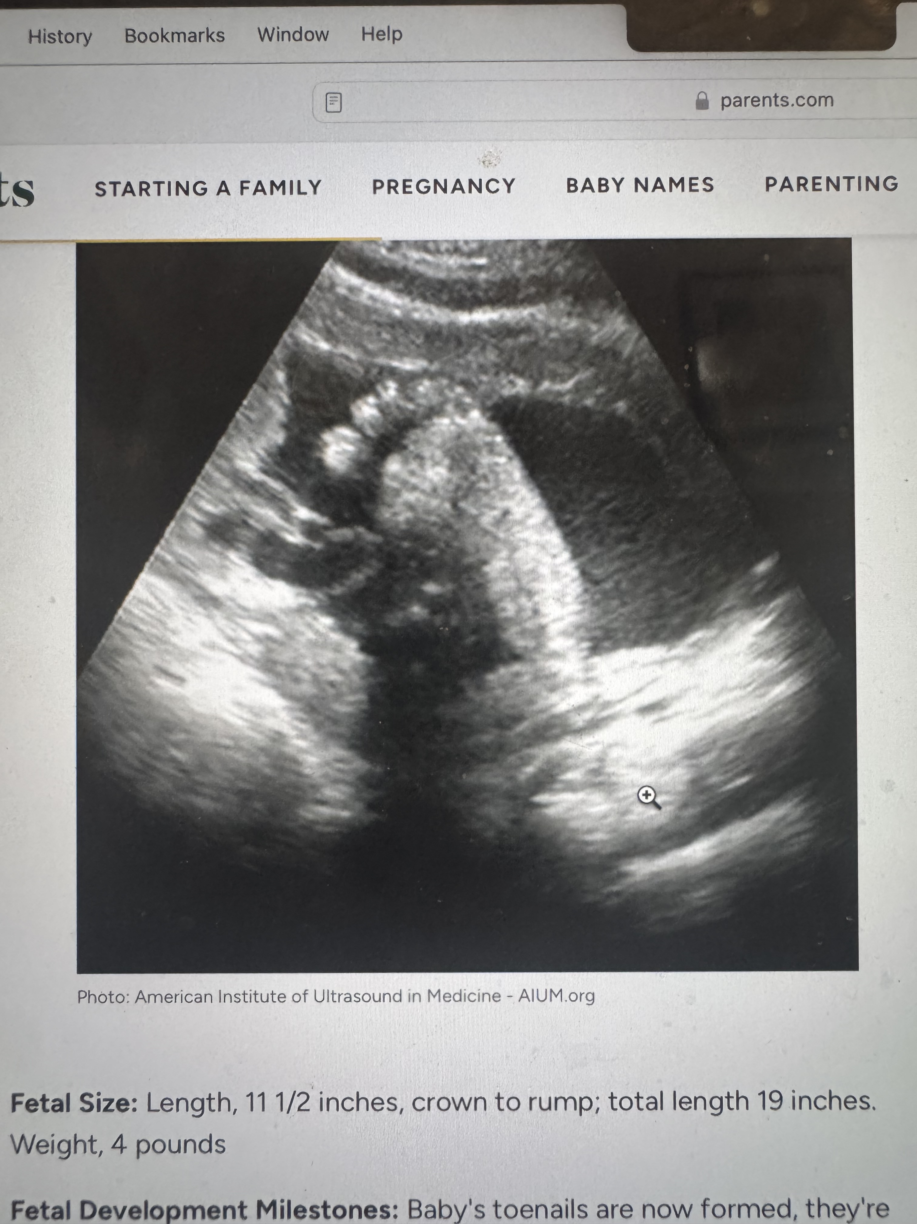
Fingernails and toenails are fully grown.
Ultrasound, 30 weeks after conception.
Photo Credit: American Institute of Ultrasound in Medicine
Notes:
Fingernails and toenails have grown to the end of the fingers and toes now.
Notice how clear the toes and foot of this 30-week-old appear on the ultrasound.
The pre-born person can grasp, stretch and kick strongly now.

Slide 5

Why Do Babies Kick in the Womb?
Video Credit: Seeker
Notes:
Teachers: We invite you to preview this video first – it shows great footage of babies kicking and moving but it also briefly shows a woman's bare stomach. You know your students best - please decide if you would like to share this with your students or not.

Slide 6
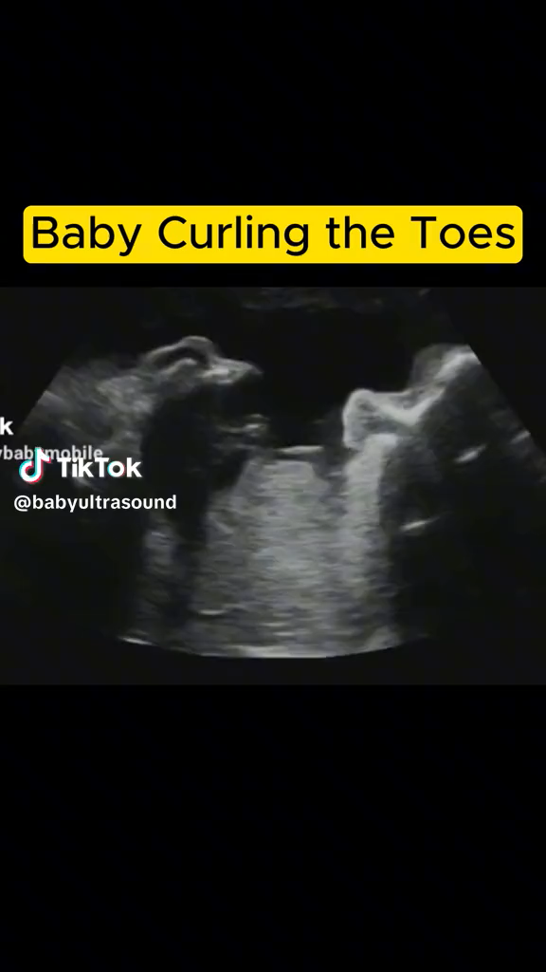
Credit: Baby Ultrasound, 2023.
Notes:
This is a short 1 minute (on a loop) video displaying a pre-born person's foot and toes moving at 32 weeks. This would be an alternative to the previous video, should you choose not to show it to your class.

Slide 7
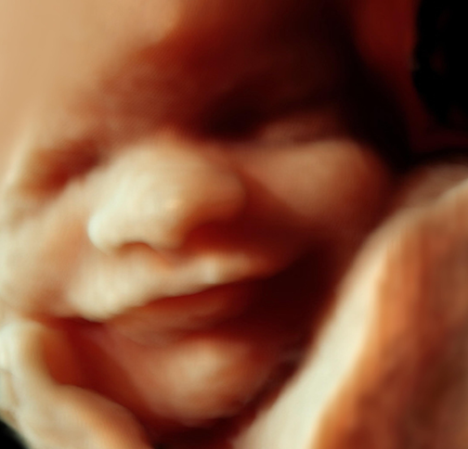
Smiles and frowns occur.
3D Ultrasound, 28 weeks after conception
Photo Credit: Science Photo Library
Notes:
The pre-born person in the womb can smile, grimace, and make faces like this one.
The pre-born person may have good head of hair.
The red blood cells form in the bone marrow.
The skin is thick and not translucent anymore.
Other than the brain and lungs – which are still maturing, the organs are well formed and ready for birth.
At the end of month 8, the pre-born person is now about 17-18 inches long and weighs as much as 5 pounds. Tucked tightly in the womb, not stretched out, the baby would be the size of a cantaloupe.

Slide 8
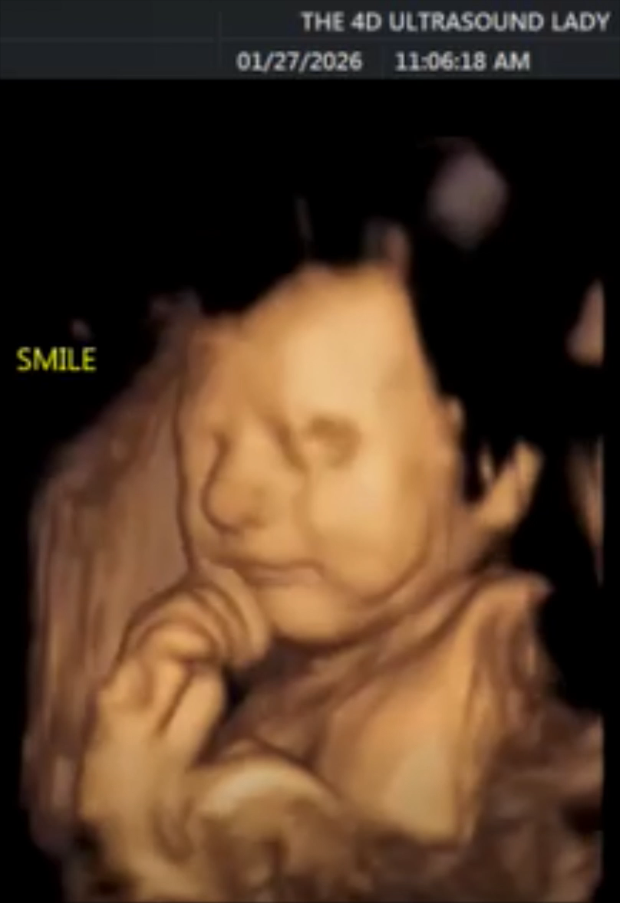
4D Ultrasound. Smiling 29-week-old [from conception]
Photo Credit: 4D Ultrasound Lady
Notes:
This is a short clip of a 4D ultrasound of a pre-born person smiling slightly in the womb.

Slide 9
Discussion Questions
Notes:
Teachers:
Please refer to the teaching manual for discussion questions.

Slide 10
Resources
Cleveland Clinic, Retrieved: June, 2025, https://my.clevelandclinic.org/health/articles/7247-fetal-development-stages-of-growth
•Video: 31 weeks (LMP) [29 Weeks from Conception]. 4D Ultrasound Lady. Facebook. https://www.facebook.com/reel/1632071181572879
Mayo Clinic, Mayo Clinic Staff (Butler Tobah, Y., M.D., Marnach, M. M.D., & Wick, M., M.D., P.h.D.), Healthy Lifestyle: Pregnancy Week by Week (n.d.), Retrieved August 20, 2020 from https://www.mayoclinic.org/healthy-lifestyle/pregnancy-week-by-week/basics/healthy-pregnancy/hlv-20049471
Photo Source: 30-week-old LMP ultrasound, American Institute of Ultrasound in Medicine, AIUM.org
Photo Source: 32-week-old LMP ultrasound of foot, American Institute of Ultrasound in Medicine, AIUM.org
“Why Do Babies Kick in the Womb?” Facebook, uploaded by Seeker, https://www.facebook.com/SeekerMedia/videos/10155720084678387/
Baby Ultrasound. (2023, December 23). Baby curling the toes [Video]. TikTok. https://www.tiktok.com/@babyultrasound/video/7316433864879263022

